Slide 1
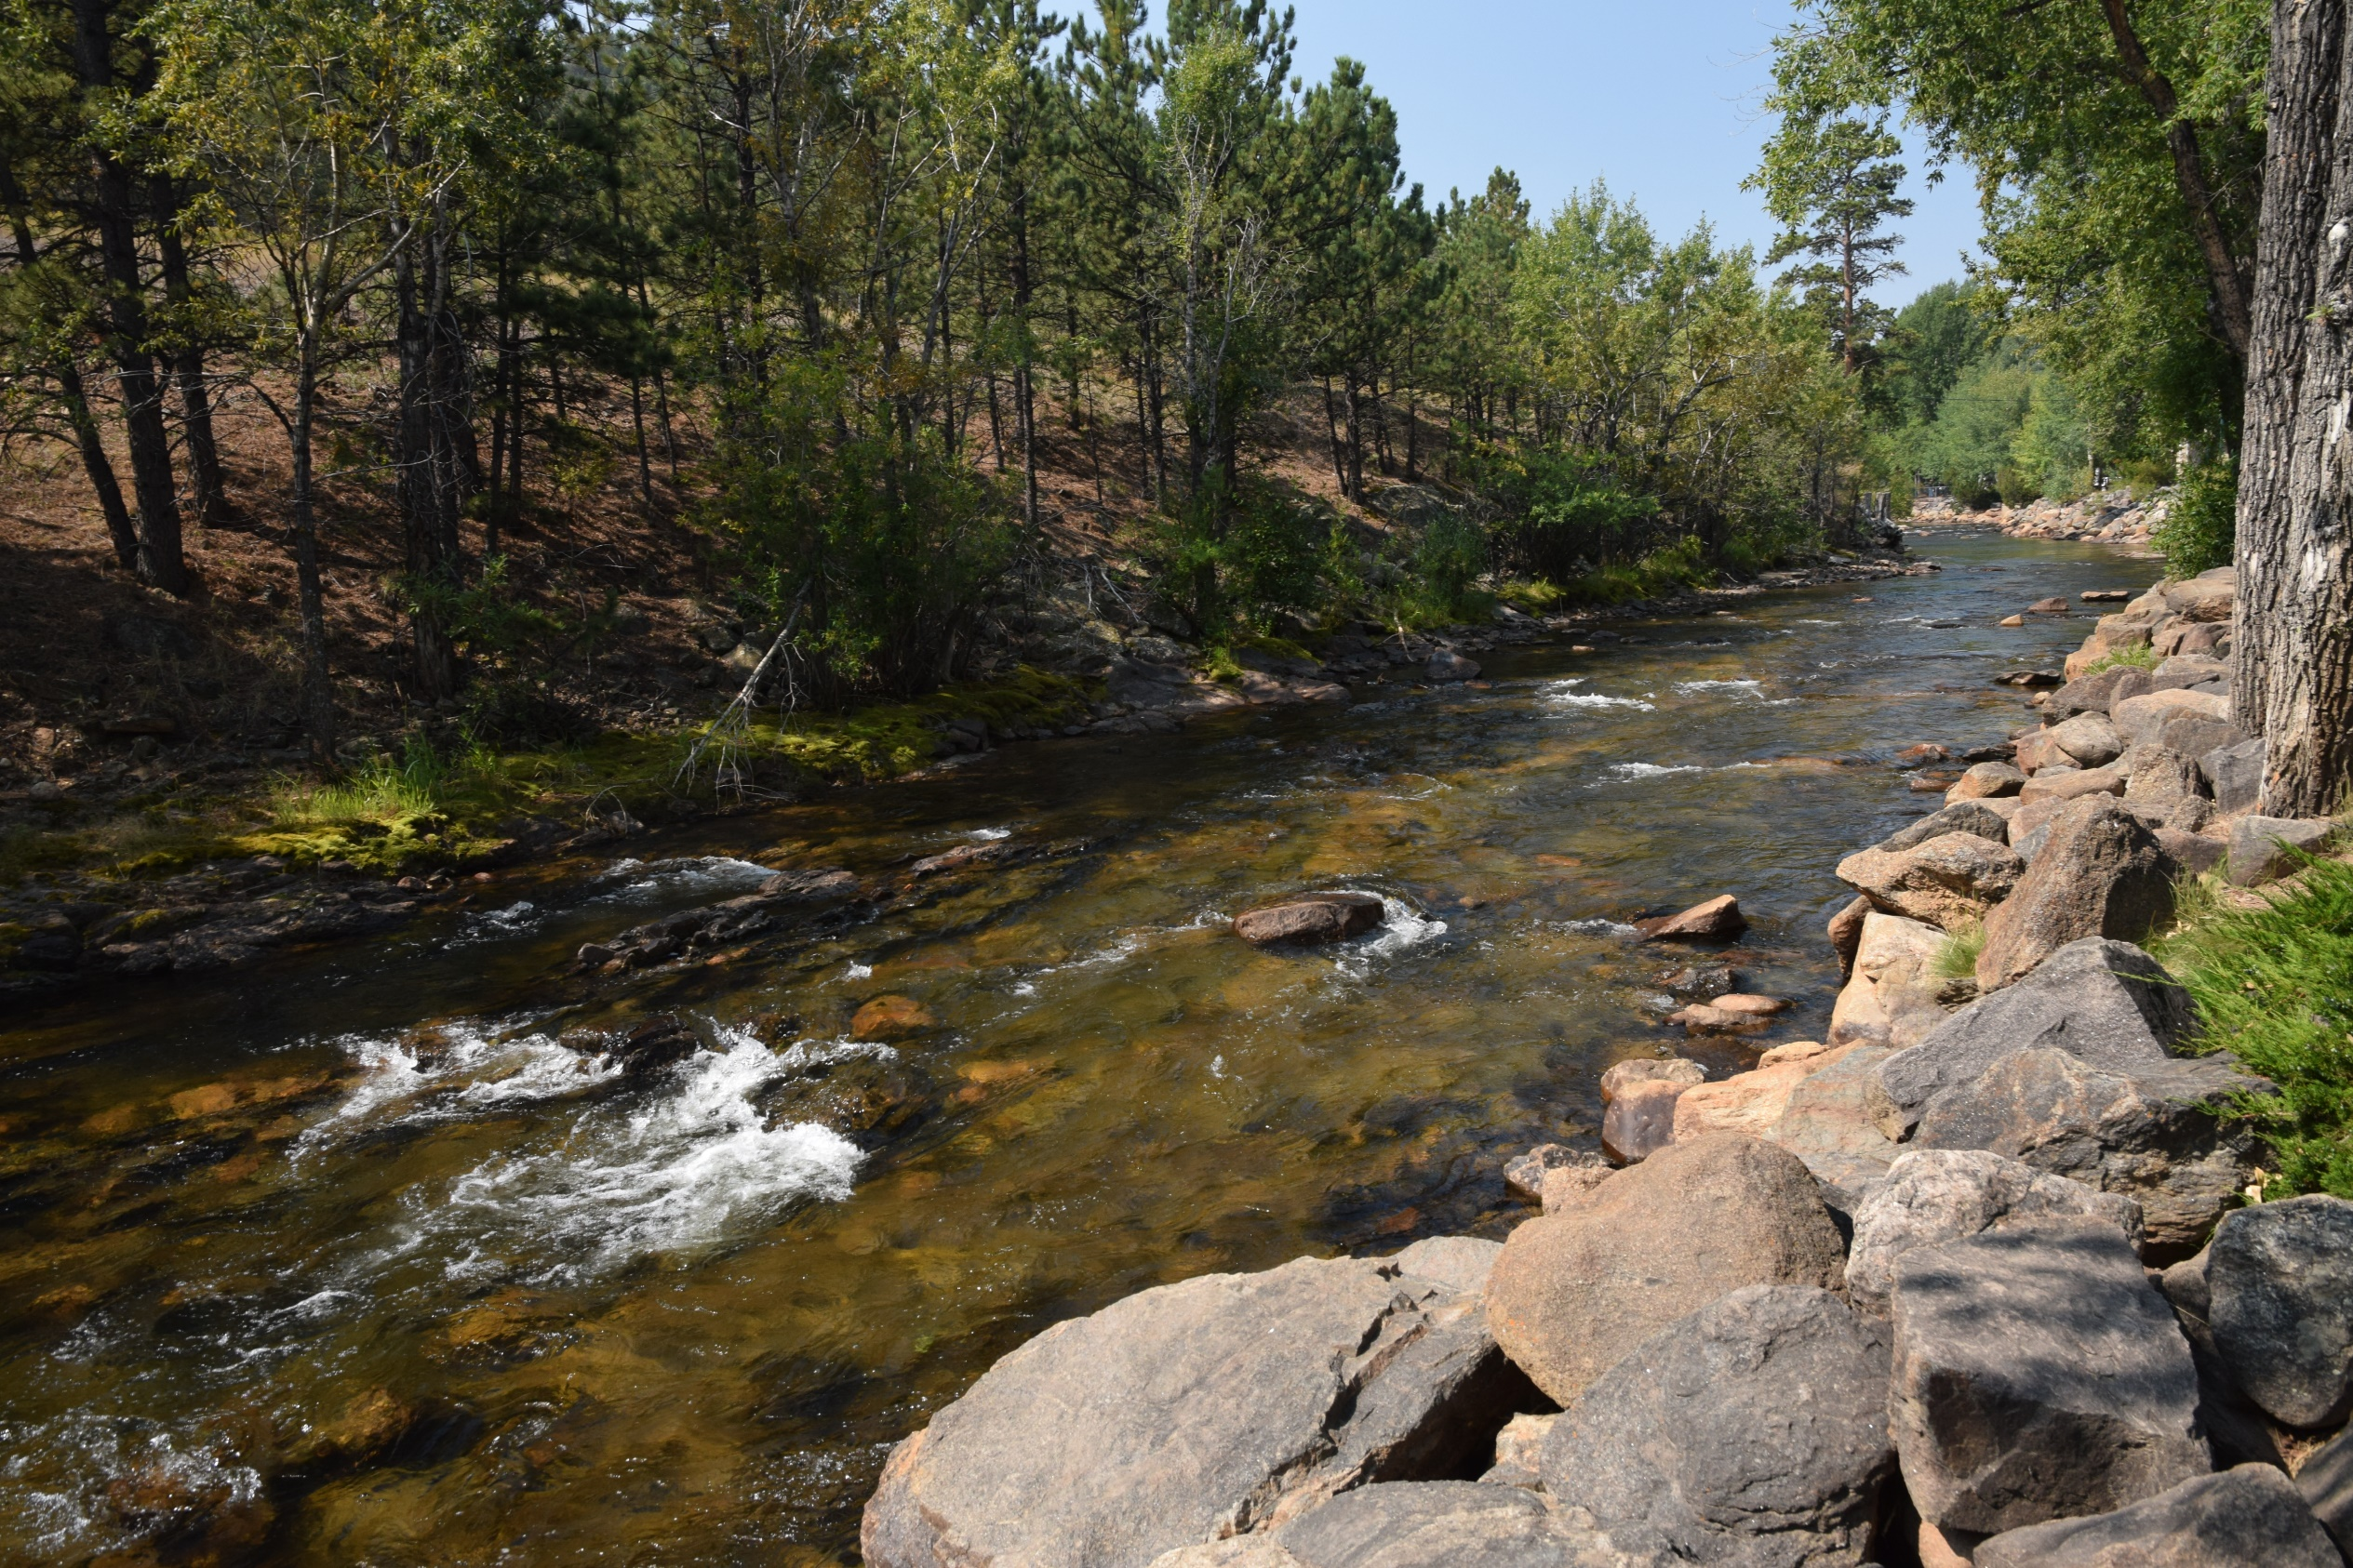
North Front Range Water Quality Planning Association Nonpoint source planning
Lazy Dog Bar & Grill
October 24, 2024
RESPEC.COM
Photo Credit:
Mark Thomas, NFRWQPA
Notes:
Mark

Slide 2
Agenda
Non-Point Source Plans Developed
The Regional Plan Project Area
The Four Local Plans
Stakeholder Involvement
Pollutants of Concern
How to Use the Plans to Determine your Priority BMPs
How to Make Your Priority BMPs a Reality!
Notes:
Mark

Slide 3
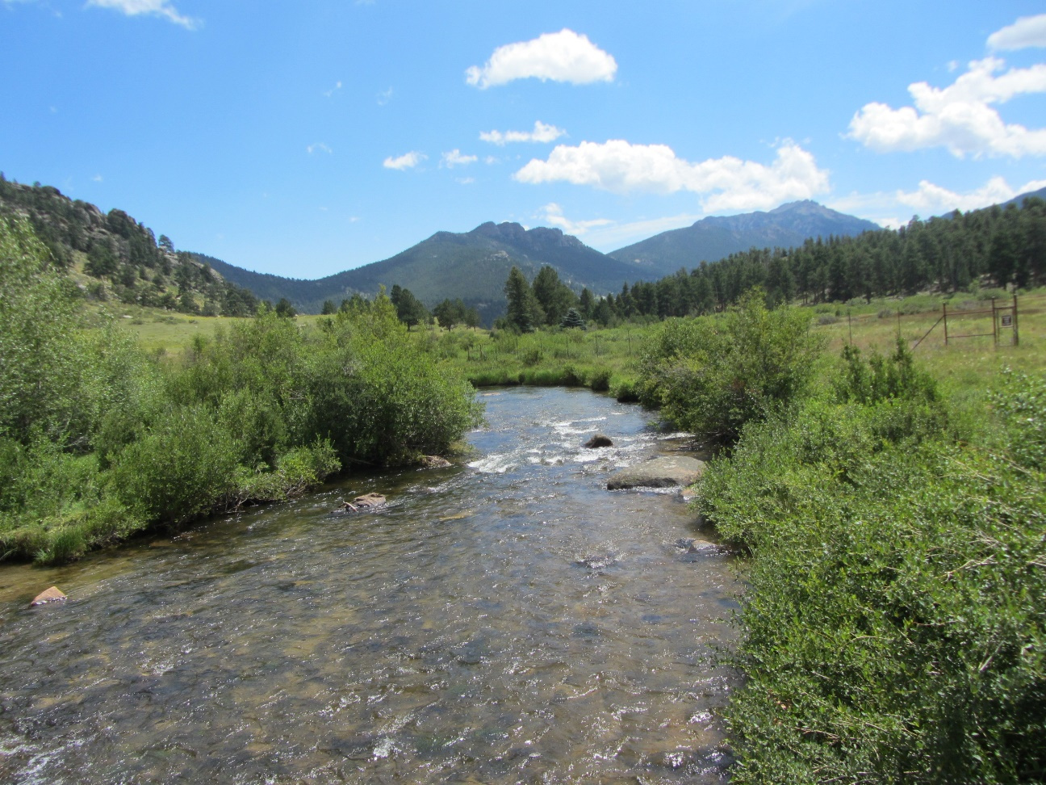
Non-Point Source Plans Developed
The Regional Plan
Four Individual 9-Key Element Implementation Plans
St. Vrain Creek
Big and Little Thompson Rivers
Cache La Poudre
Middle South Platte
Photo Credit: Mark Thomas, NFRWQPA
Notes:
Mark

Slide 4
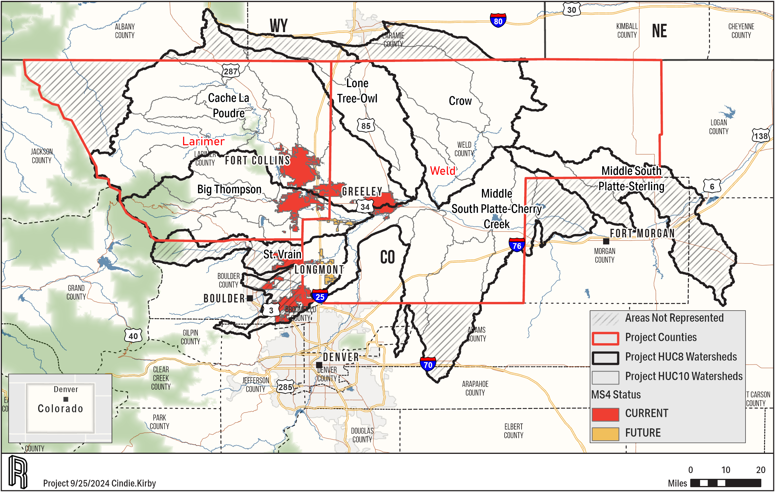
Regional Plan and Individual Plans
Full Project Area and Individual Areas
Special Emphasis on Future MS4 Areas (Yellow)
Areas in Larimer and Weld Counties Only
Major Watersheds
Current MS4s not Included
Point Sources not Included
Notes:
Mark

Slide 5
Stakeholders Involvement
Surveys
Meetings
Public Notice
Organization Name
Big Thompson Watershed Coalition (BTWC) | Ducks Unlimited | Town of Erie
Big Thompson Watershed Forum | Estes Park Sanitation District | Town of Estes Park
Boxelder Sanitation District | Estes Valley Watershed Coalition | Town of Evans
Brink Corp | FPAC-NRCS, CO | Town of Firestone
Carestream | Fresh Water Trust | Town of Frederick
City of Dacono | JBS Greeley Beef Plant | Town of Gilcrest
City of Fort Collins | Larimer County | Town of Johnston
City of Greeley | Left Hand Water District | Town of Kersey
City of Longmont | Little Thompson Watershed Coalition | Town of Keenesburg
City of Loveland | Los Rios Farm | Town of La Salle
Coalition for the Poudre River Watershed (CPRW) | Northern Colorado Water Conservancy District | Town of Mead
Colorado Ag Water Alliance (CAWA) | Peaks to People Water Fund | Town of Milliken
Colorado Department of Public Health and Environment (CDPHE) | Poudre Heritage Alliance | Town of Pierce
Colorado Livestock Association | RNC Consulting, LLC | Town of Severance
Colorado Parks & Wildlife | St. Vrain Creek and Boulder Creek Watershed | Town of Timnath
Colorado Rural Water Association | St. Vrain Sanitation District | Town of Wellington
Colorado State University (CSU) | South Fort Collins Sanitation District | Town of Windsor
Colorado Watershed Assembly | South Platte Basin Roundtable | Trout Unlimited
Colorado Wheat Administrative Committee | Thompson School District | Upper Thompson Sanitation District
Community of Fox Acres | Town of Ault | Weld County
Davies Mobile Home Park | Town of Berthoud | Xcel Energy
Drala Mountain Center | Town of Eaton
Notes:
Mark

Slide 6
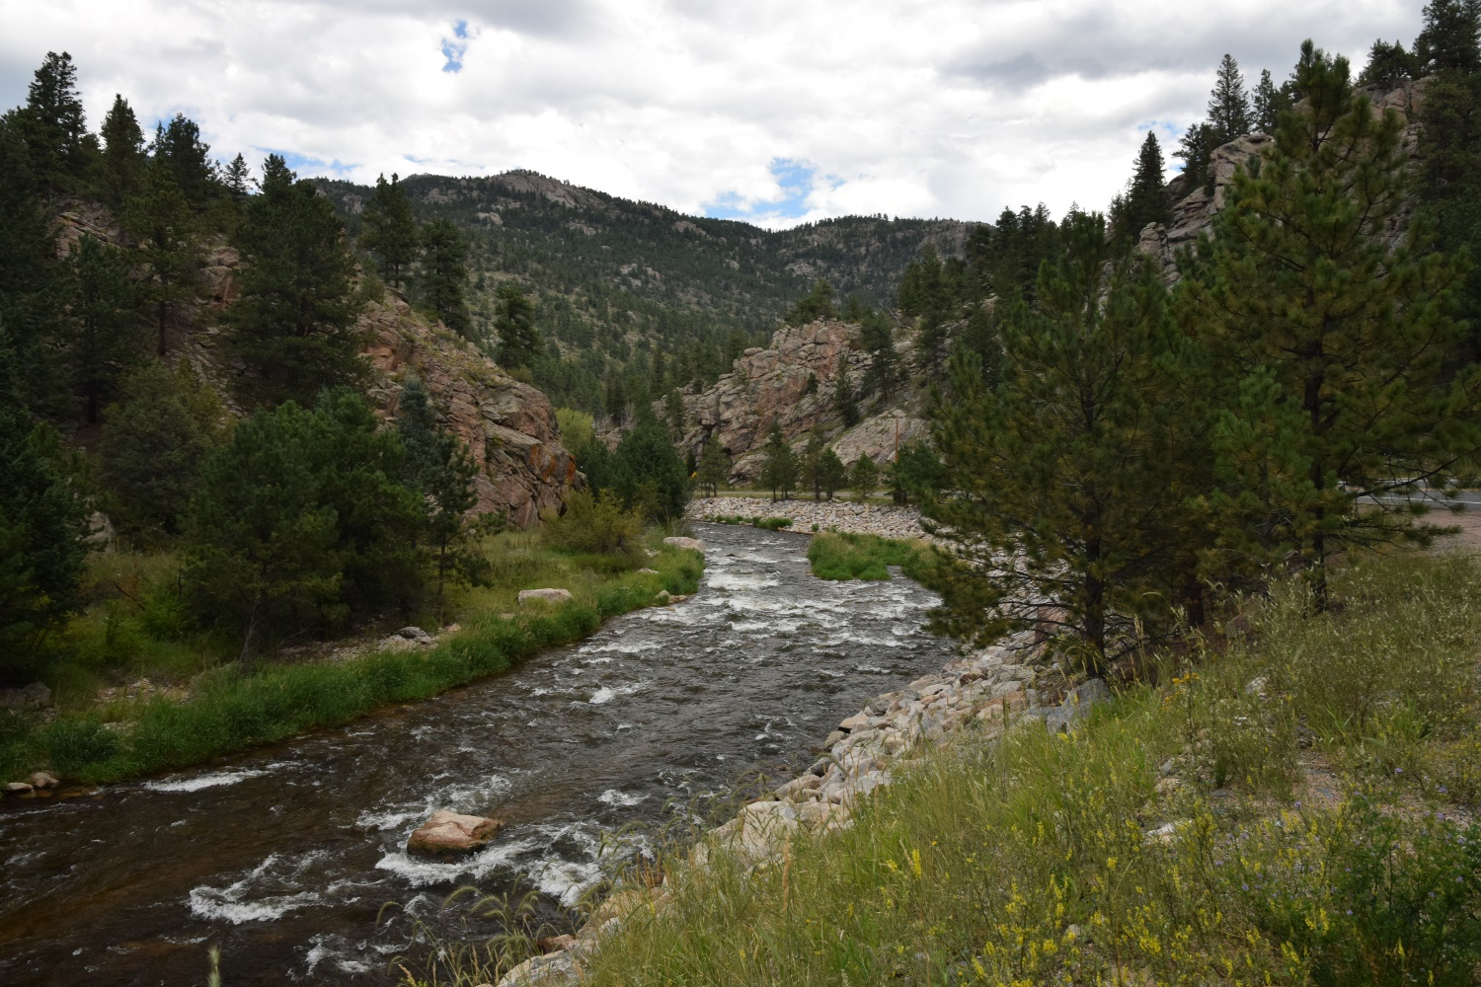
Parameters of Concern
Addressed with Plan BMPs
Nutrients (Nitrogen and Phosphorus)
Sediment
E. coli
Heavy Metals
Not Addressed with Plan BMPs
Temperature
Emerging Contaminants
PFAS (per- and polyfluoroalkyl substances)
Photo Credit: Mark Thomas, NFRWQPA
Notes:
Mark

Slide 7
How to use the individual Plans
Flowchart
Are you a landowner or a decision maker?
What is your area of concern?
What watershed are you concerned with?
All or one specific?
Find your area and review sources in your HUC10 or area of concern
What land use are you concerned with?
All or one specific?
Find your land use and review sources in your HUC10 or area of concern
Identify the priority practices for your area and land cover of concern
Review the priority practice tables
Identify technical and funding sources for your area of concern
Work with local sources to achieve appropriate technical and funding
Implement practices
Notify NFRWQPA of practice types and locations
NFRWQPA can evaluate if monitoring to evaluate goals around practices installed
Notes:
Mark

Slide 8
Example Sources Table
Included in Individual Plans
Sediment example
Also available for nitrogen, phosphorus, E. coli, etc.
Use these tables to review problem land uses by watershed
HUC10 | Description | Area (mi²) | Urban Non-MS4 (%) | Cropland (%) | Pastureland (%) | Forest (%) | Feedlots (%) | Other Land Uses (%) | Septic (%)
1019000601 | North Fork Big Thompson River | 85 | 26 | 0 | 0 | 60 | 0 | 14 | 0
1019000602 | Headwaters Big Thompson River | 184 | 66 | 0 | <1 | 22 | 0 | 11 | 0
1019000603 | Buckhorn Creek | 145 | 20 | 11 | 2 | 37 | 0 | 31 | 0
1019000604 | Headwaters Little Thompson River | 91 | 14 | 0 | 1 | 68 | 0 | 17 | 0
1019000605 | Dry Creek-Little Thompson River | 86 | 7 | 90 | 1 | <1 | 0 | 2 | 0
1019000606 | Outlet Big Thompson River | 161 | 8 | 86 | 2 | 2 | 0 | 2 | 0
Notes:
Mark

Slide 9
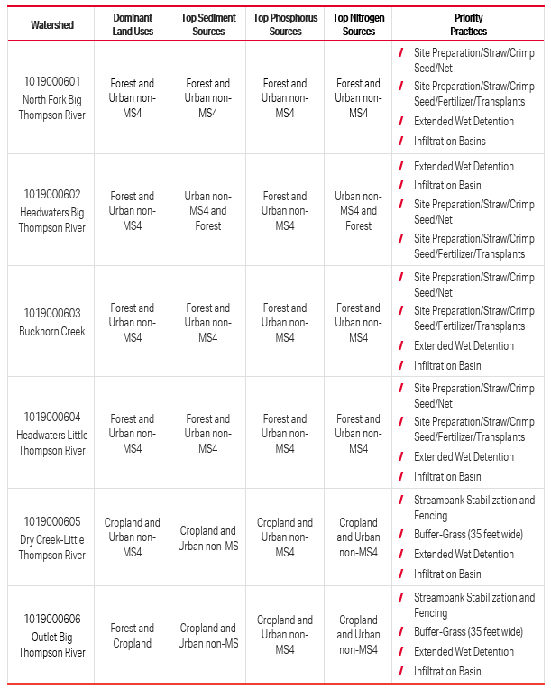
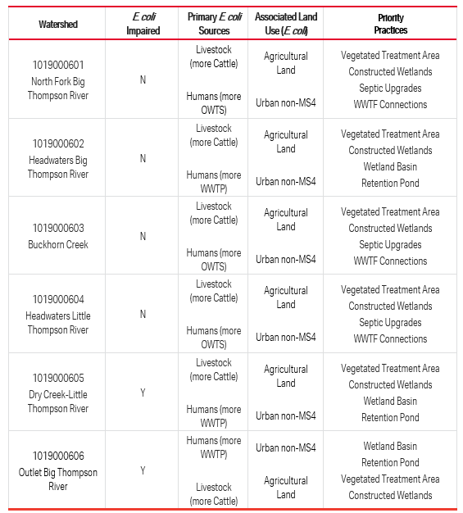
Example Priority Practice Tables (Nutrients/Sediment and E. coli)
In Individual Plans
Use These Tables to Identify BMPs for Your Watershed
Notes:
Mark

Slide 10
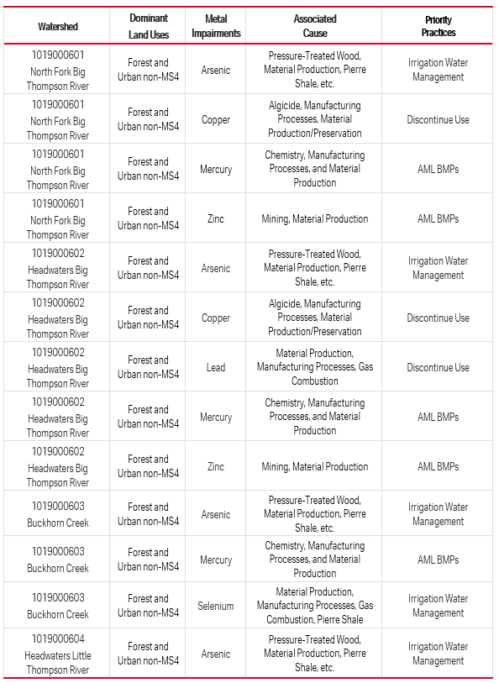
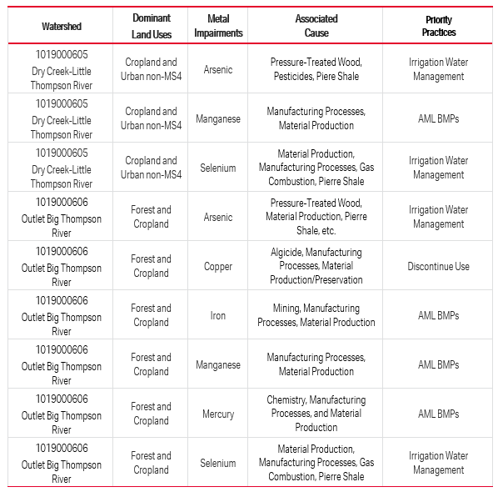
Example Priority Practice Tables (Heavy Metals)
In Individual Plans
Use These Tables to Identify BMPs for Your Watershed
Notes:
Mark

Slide 11
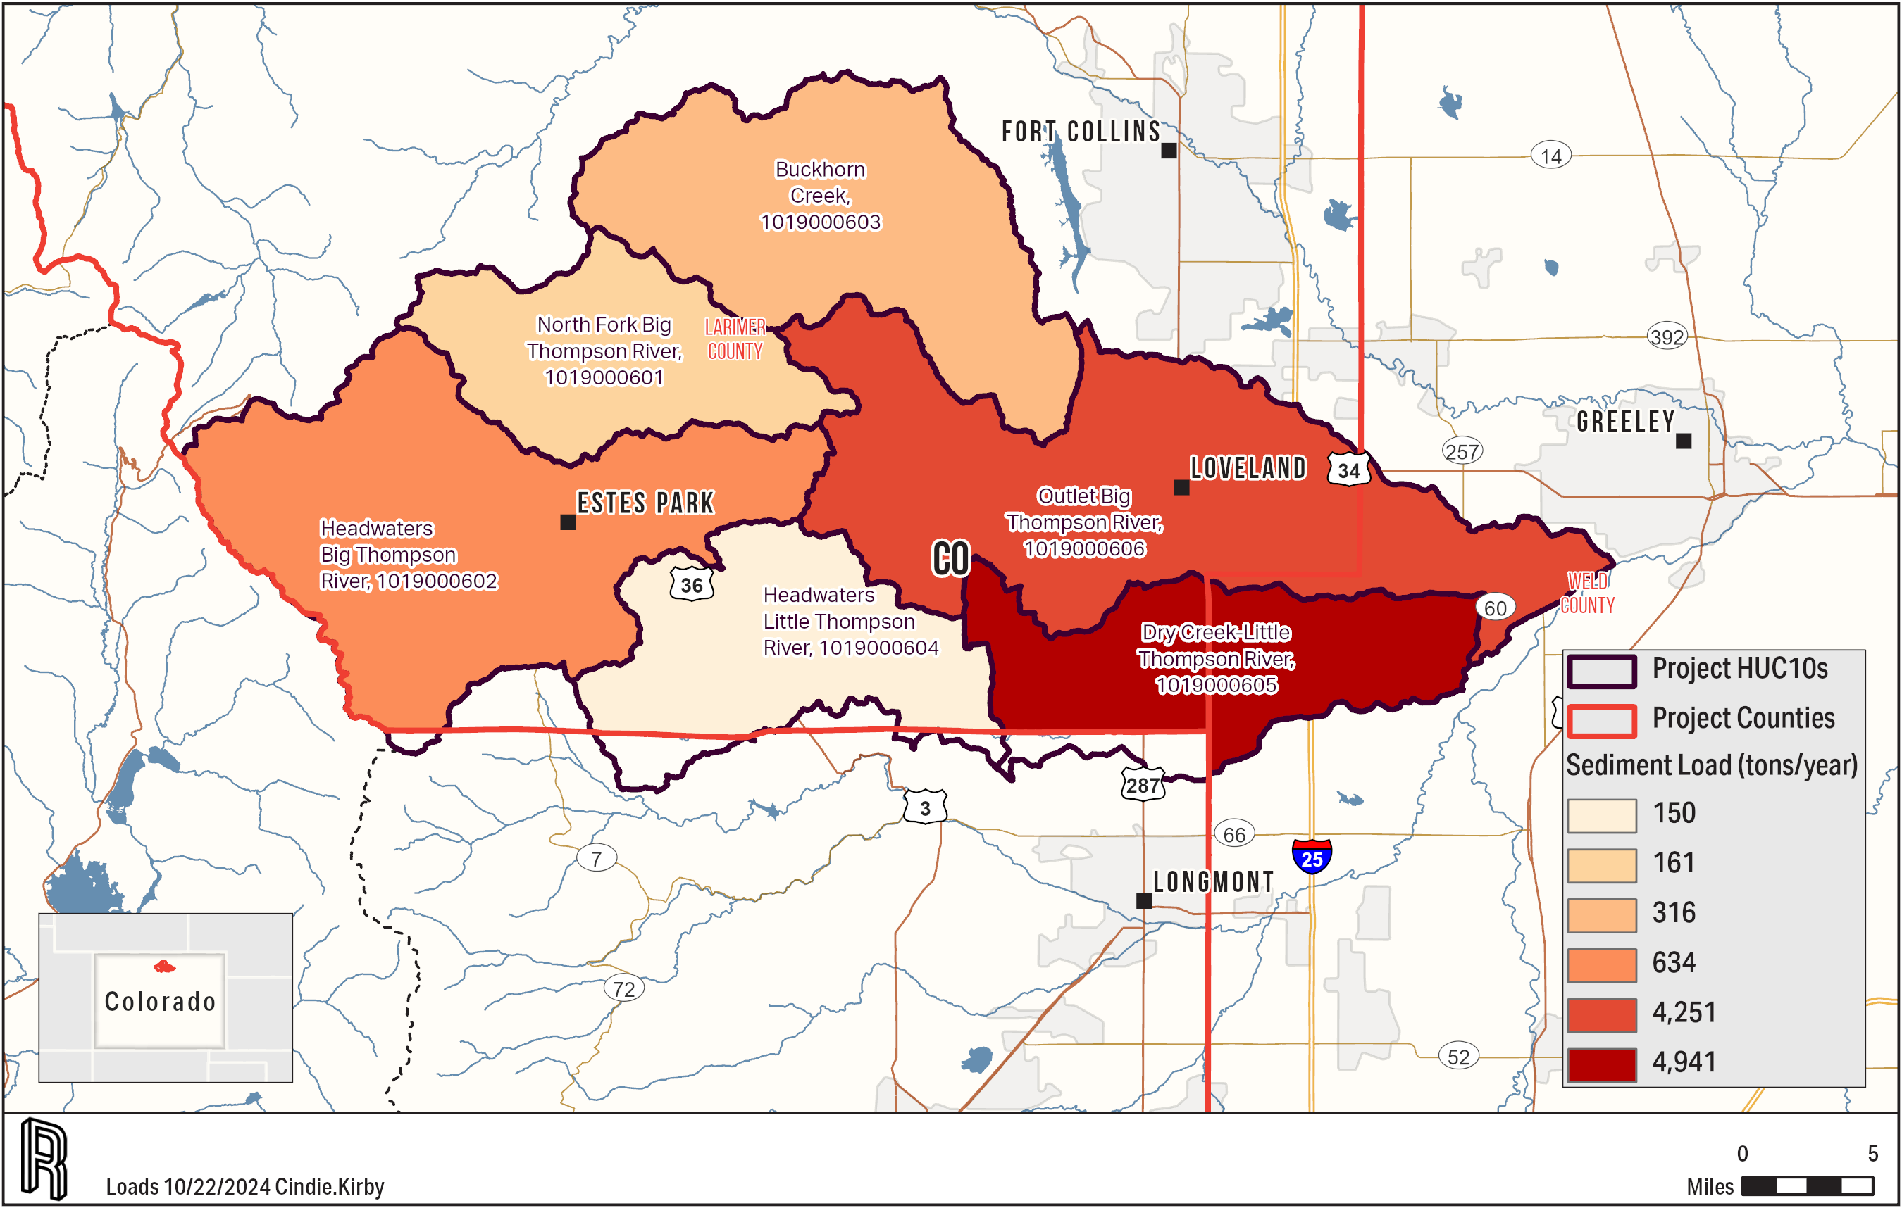
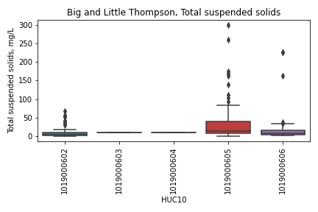
Big/Little Thompson Sediment
Notes:
Alan

Slide 12
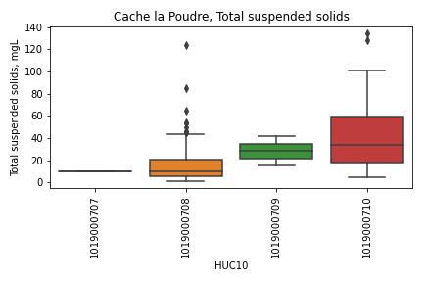
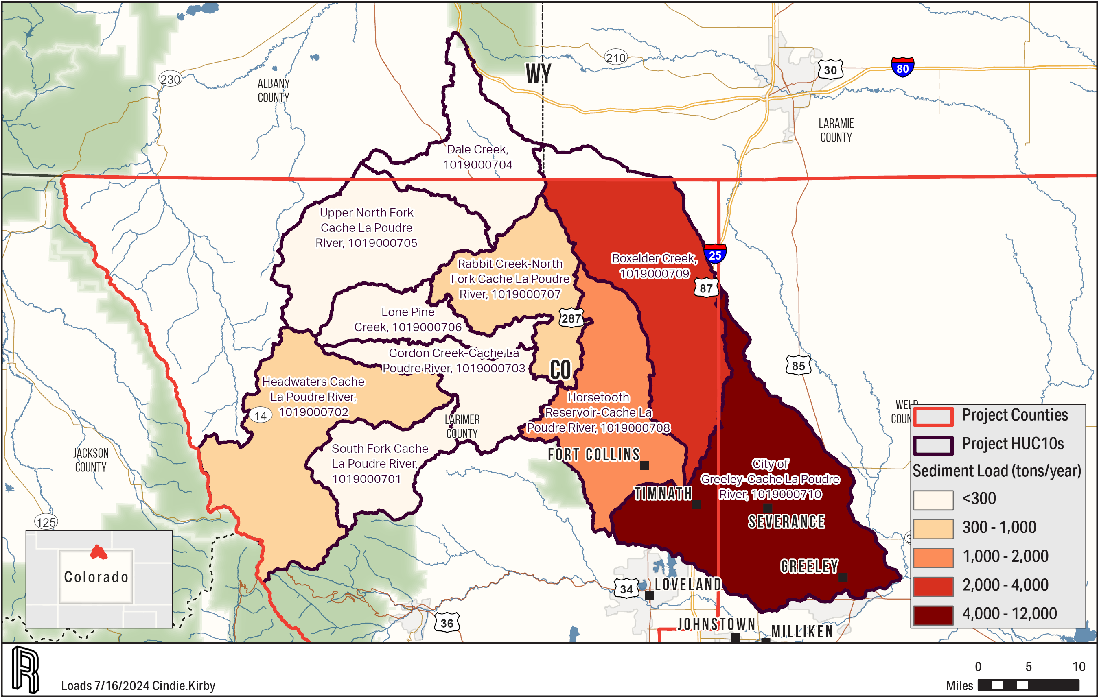
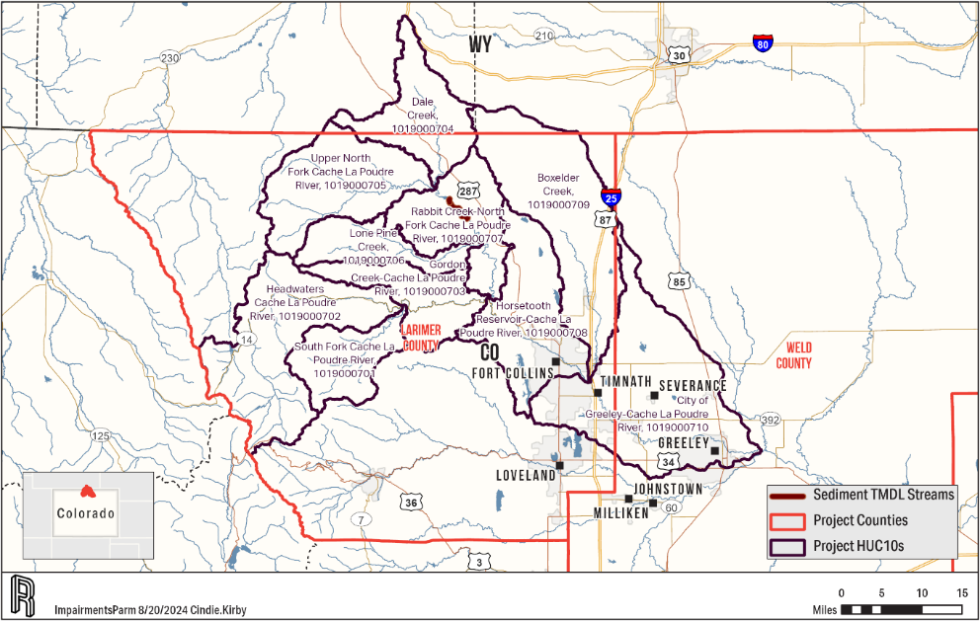
Cache la Poudre Sediment
Notes:
Alan

Slide 13
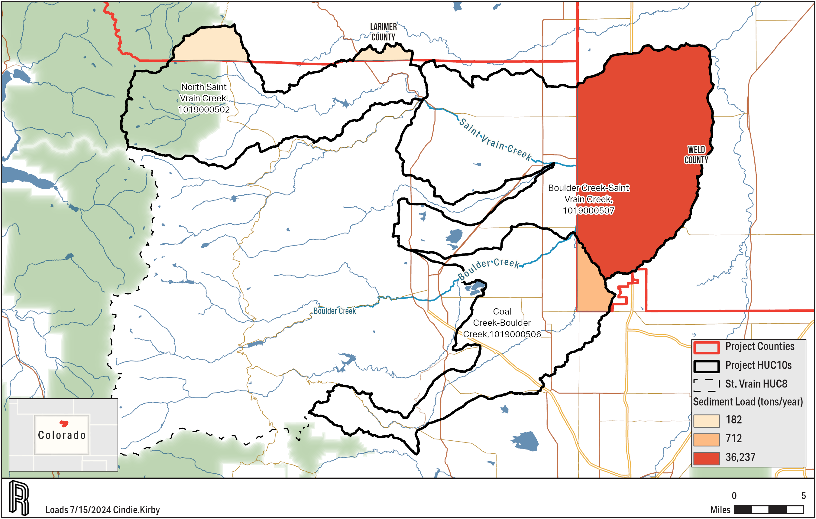
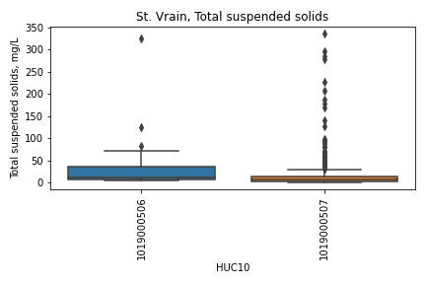
Saint Vrain Sediment
Notes:
Alan

Slide 14
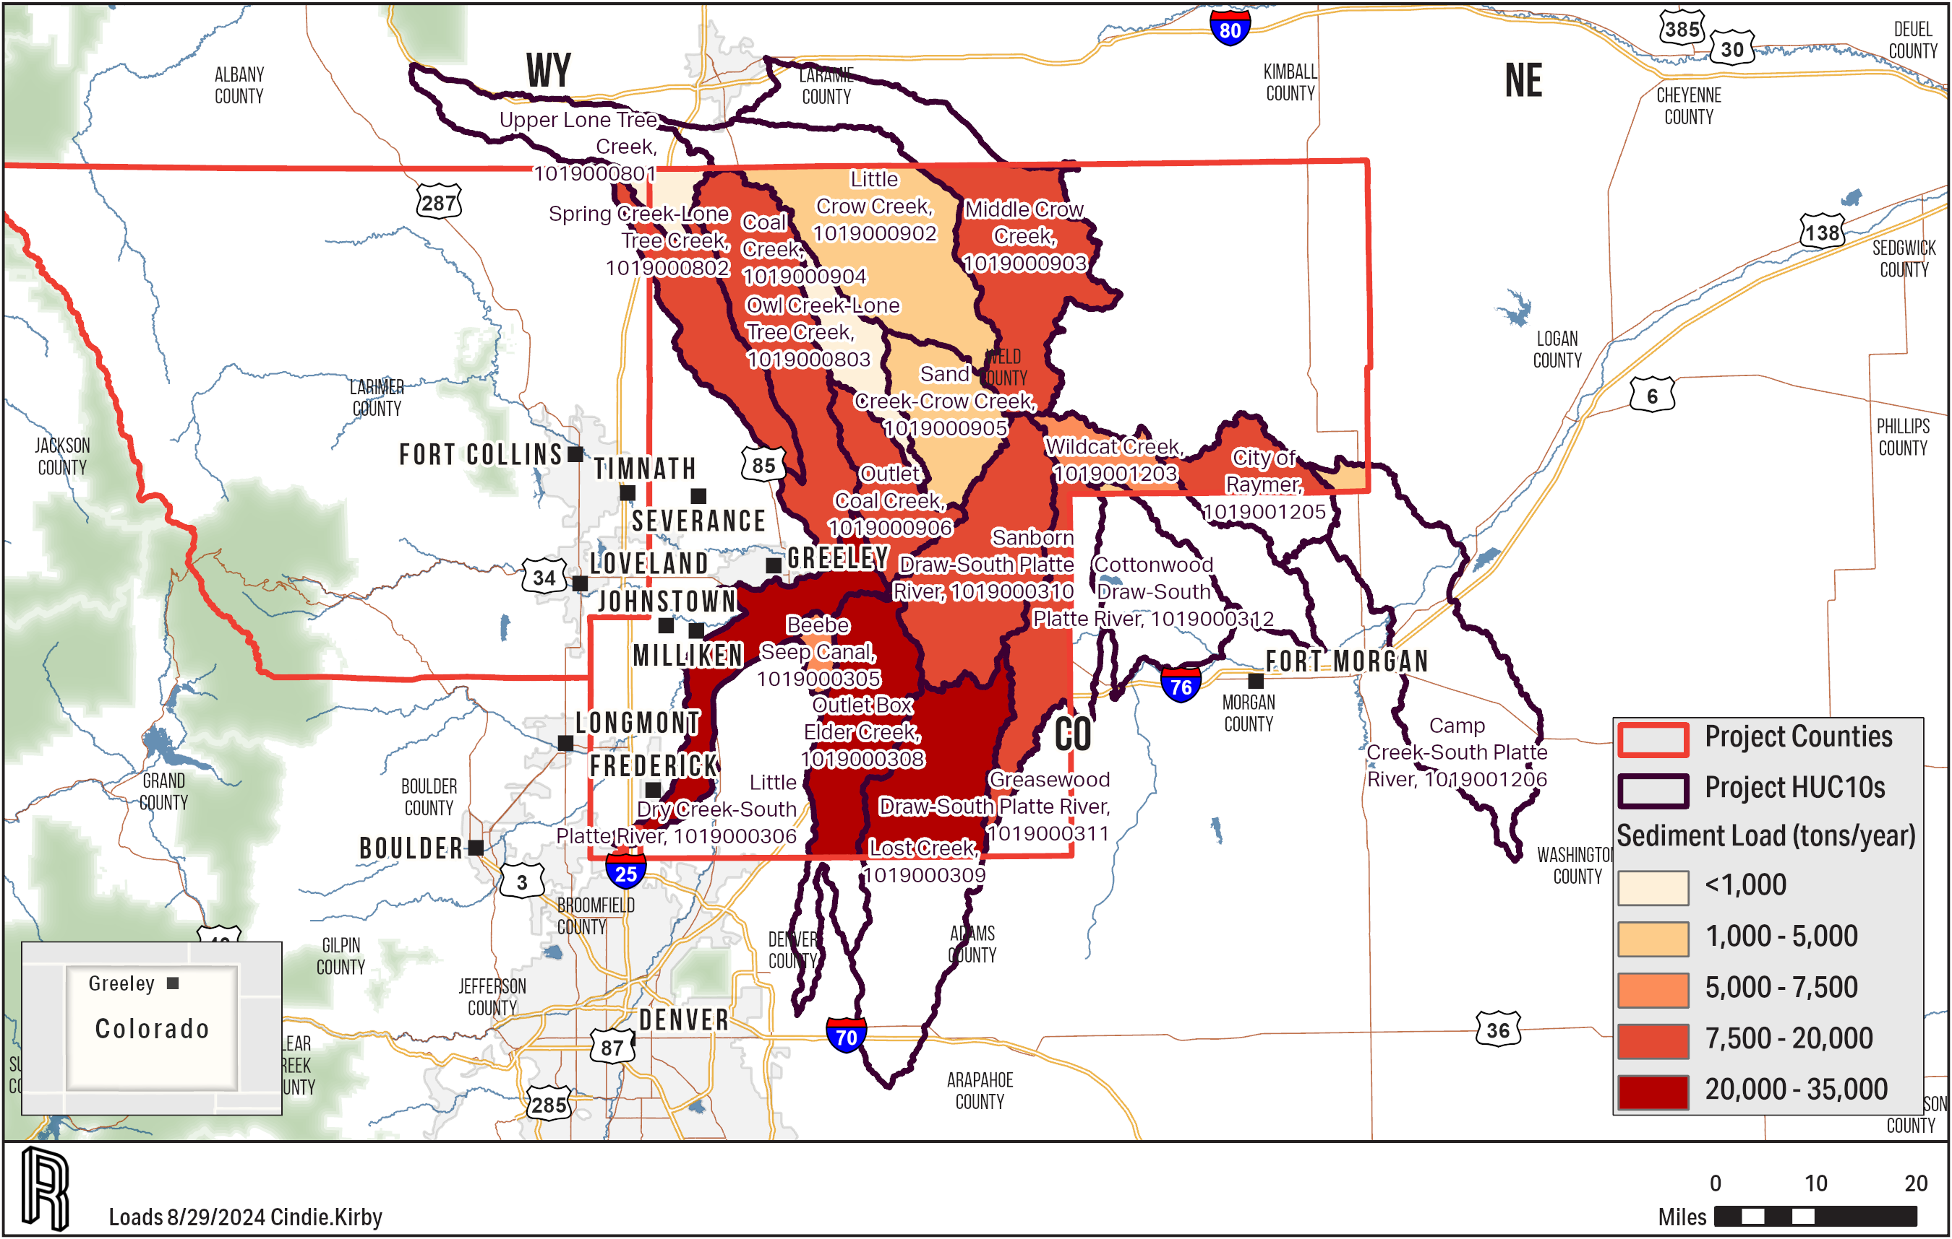
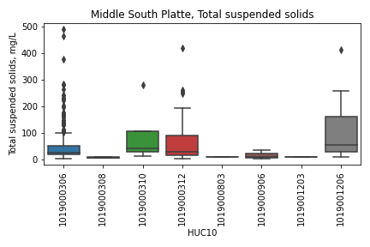
Middle South Platte Sediment
Notes:
Alan

Slide 15
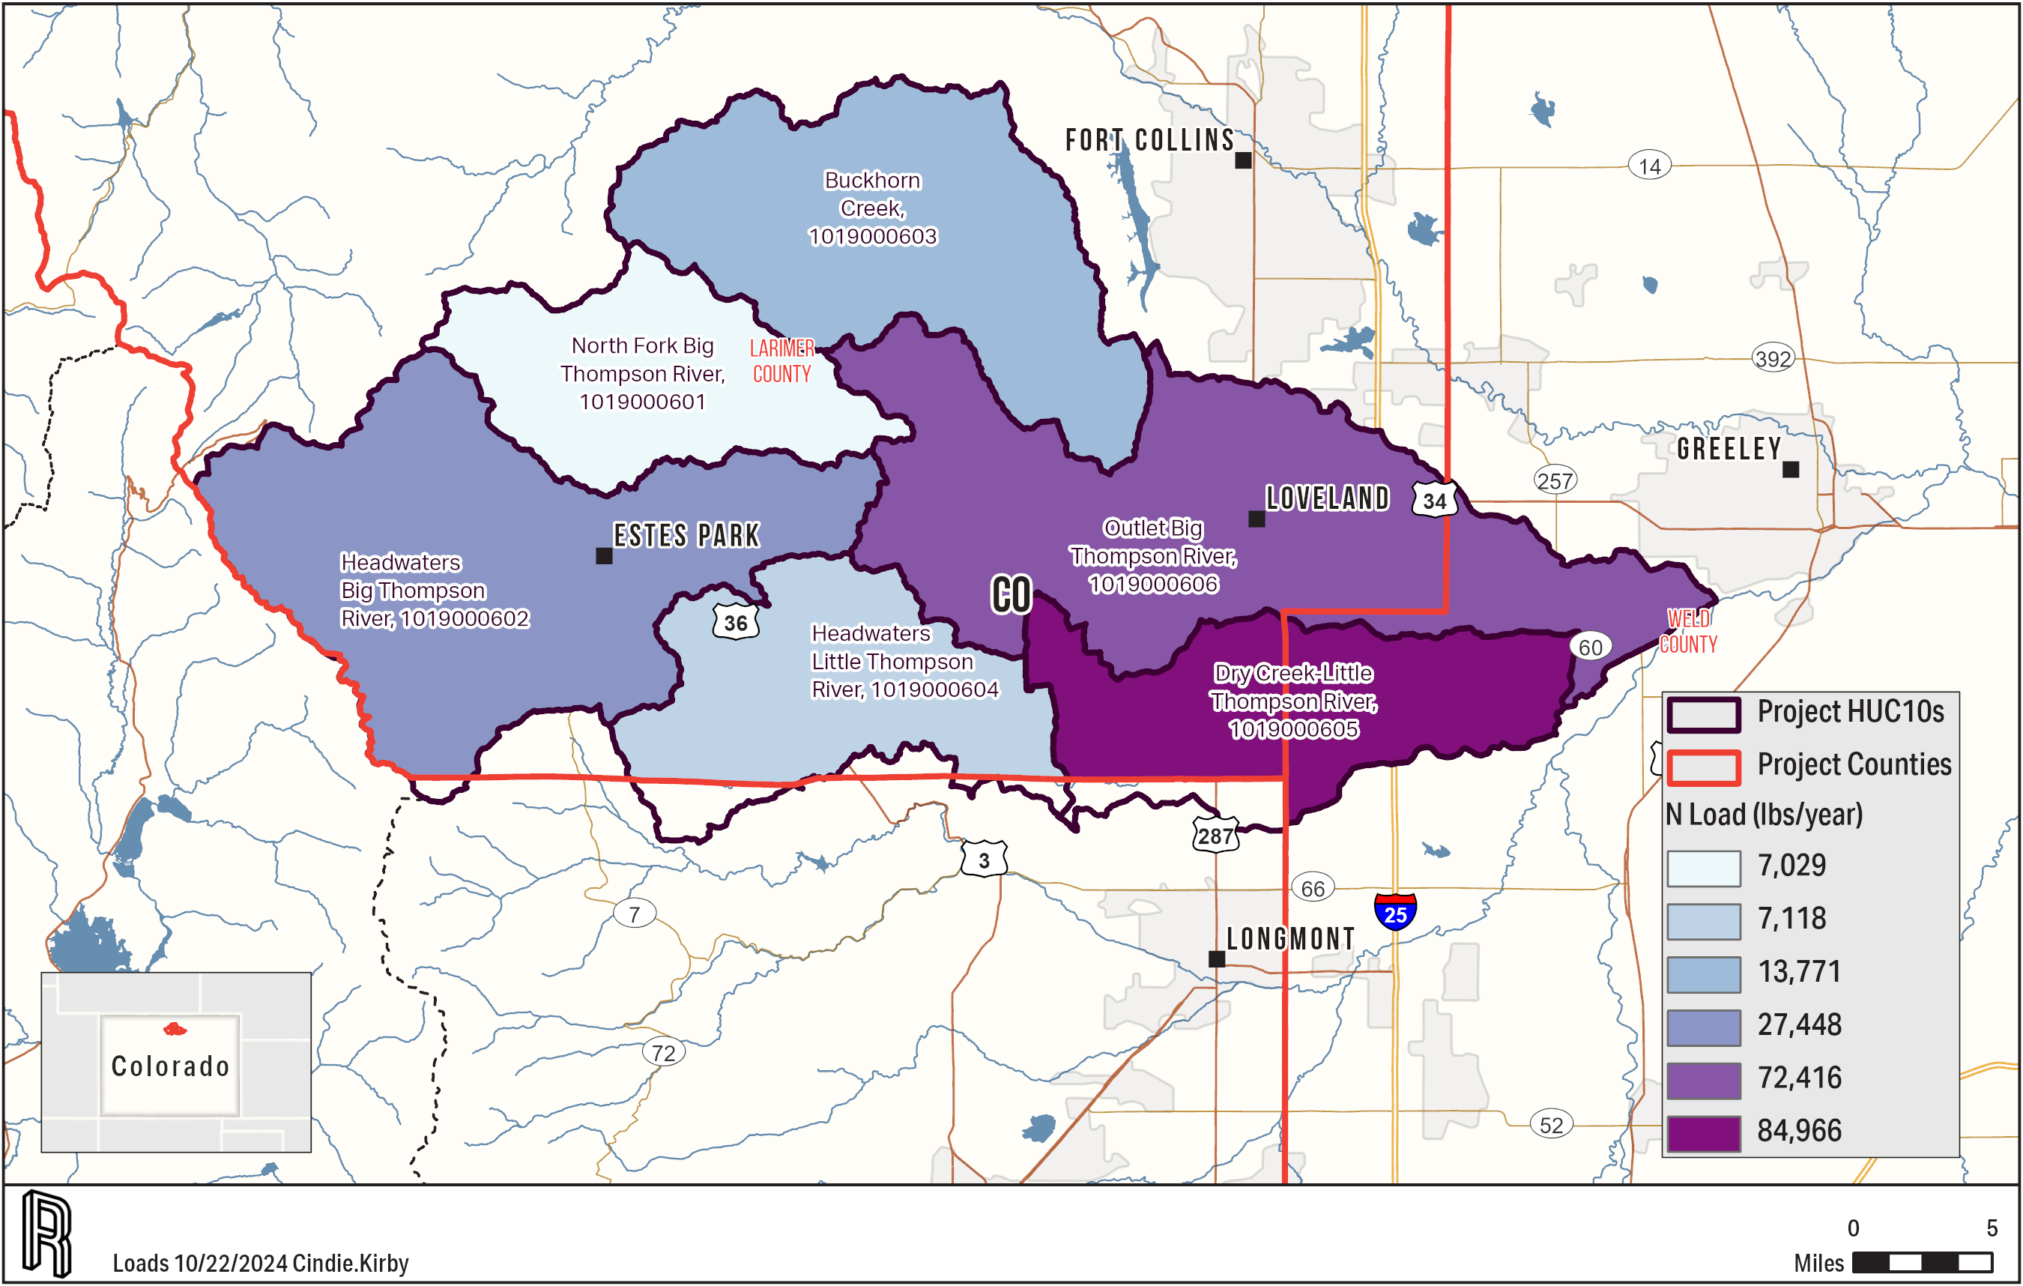
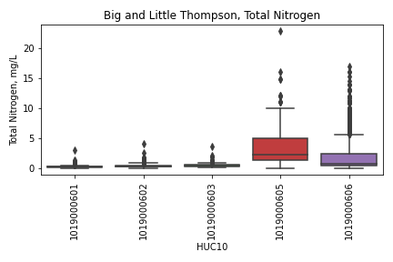
Big/Little Thompson Nitrogen
Notes:
Alan

Slide 16
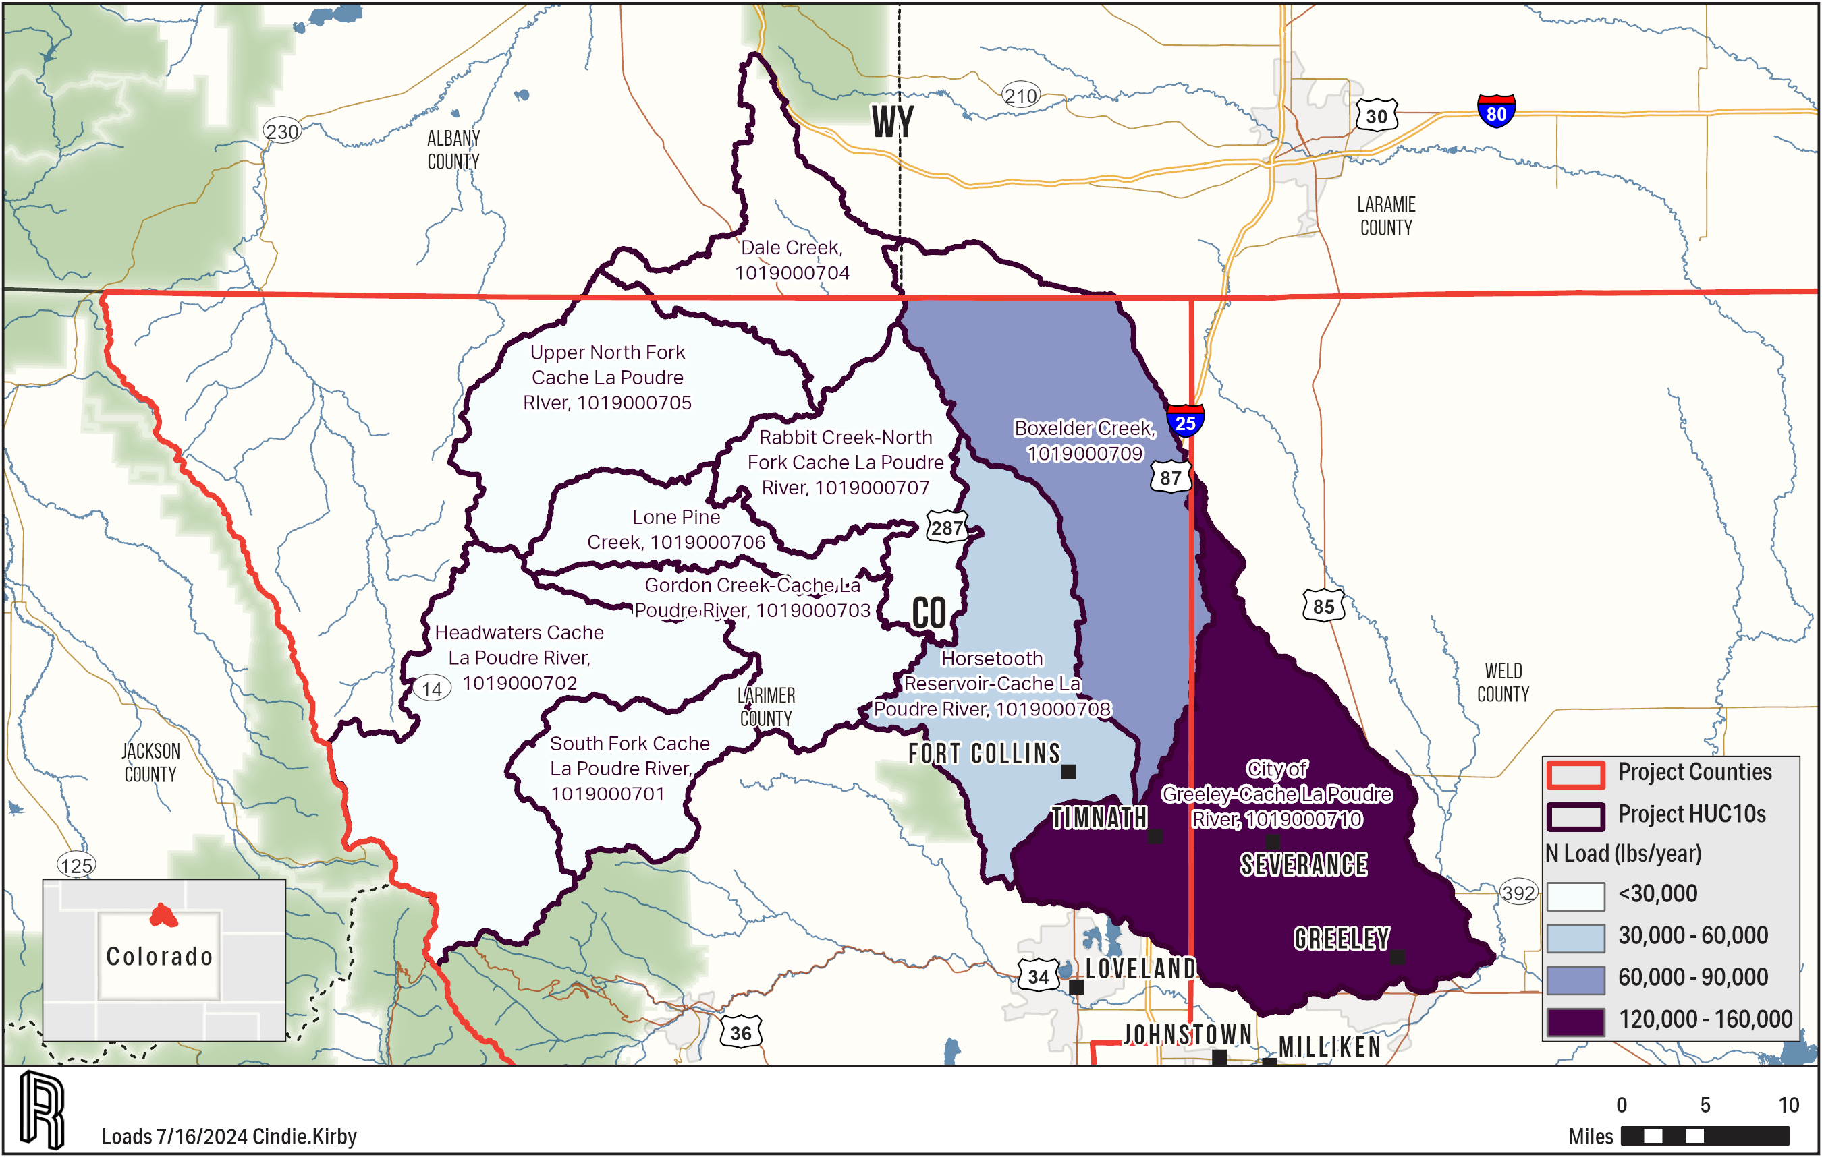
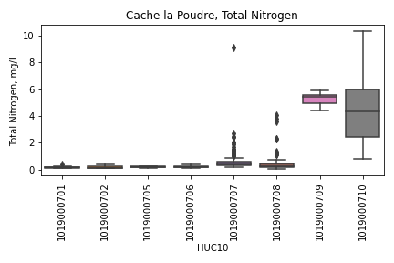
Cache la Poudre Nitrogen
Notes:
Alan

Slide 17
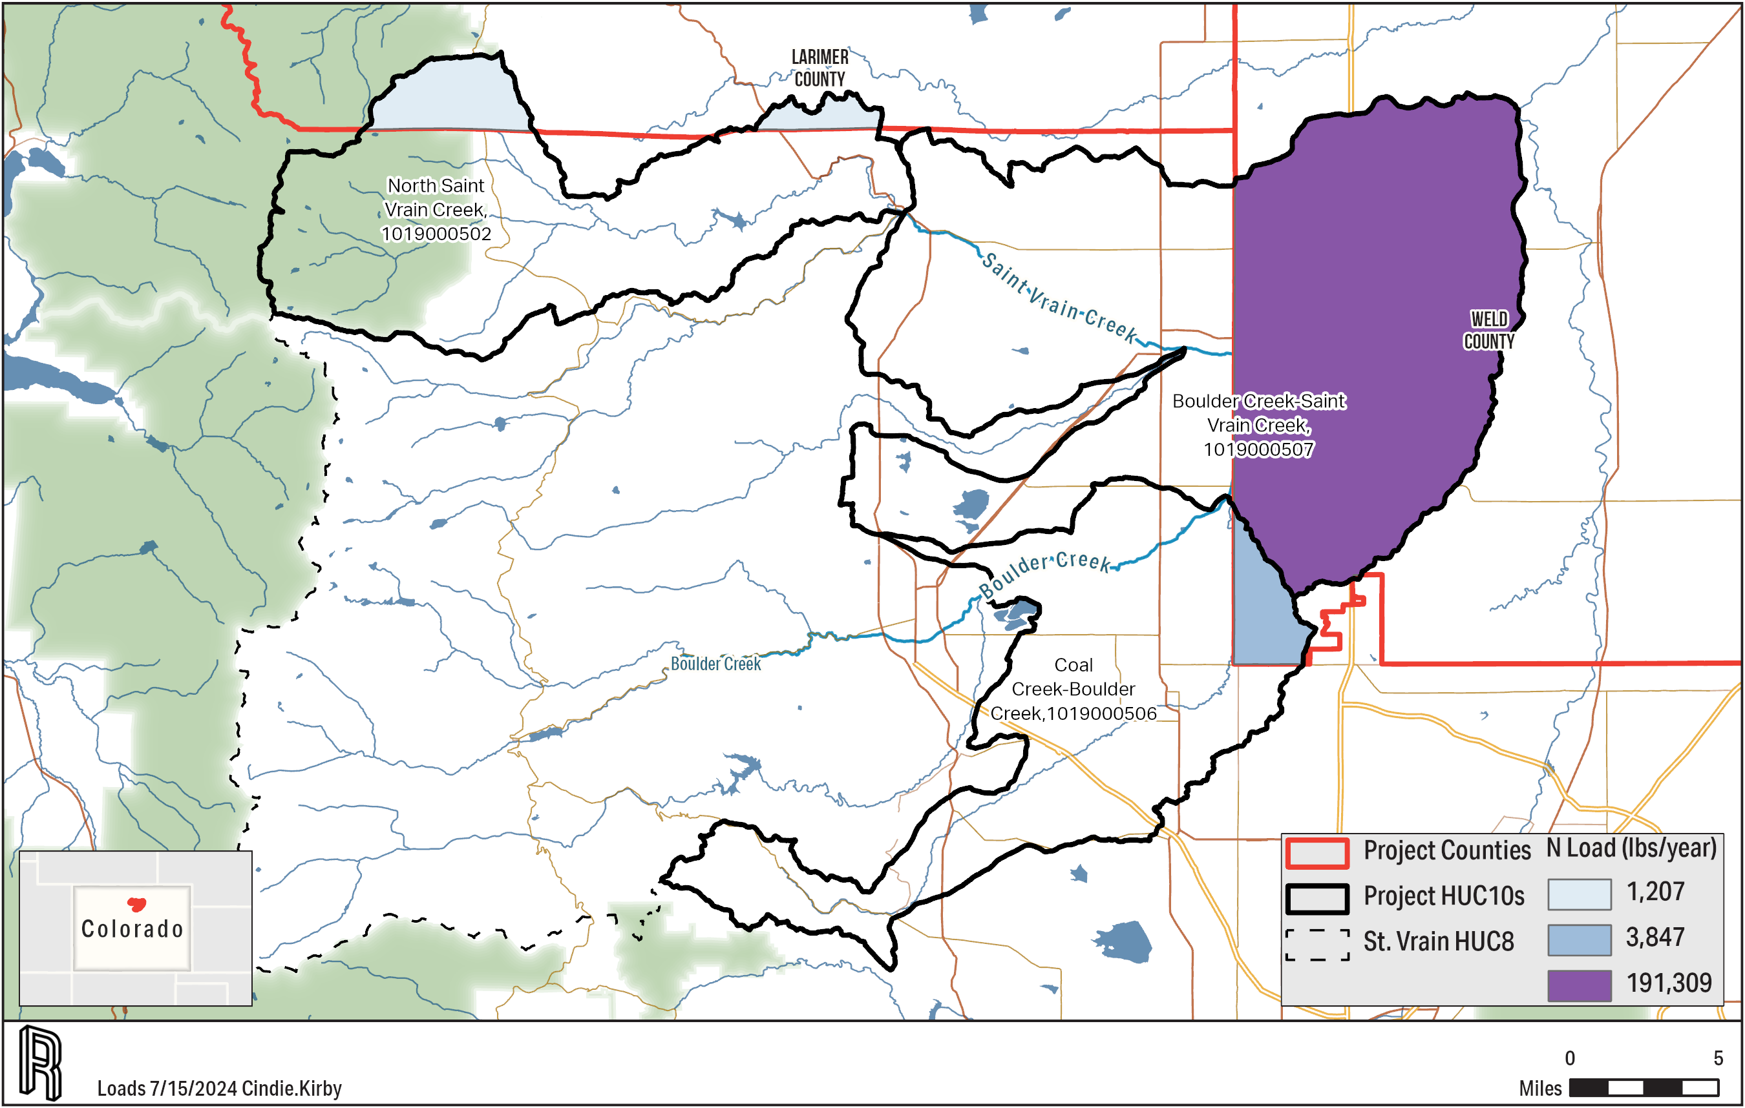
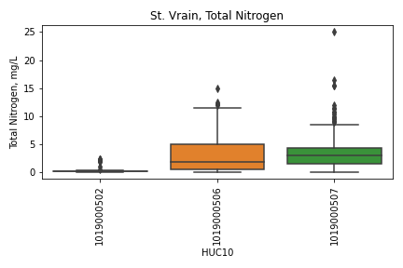
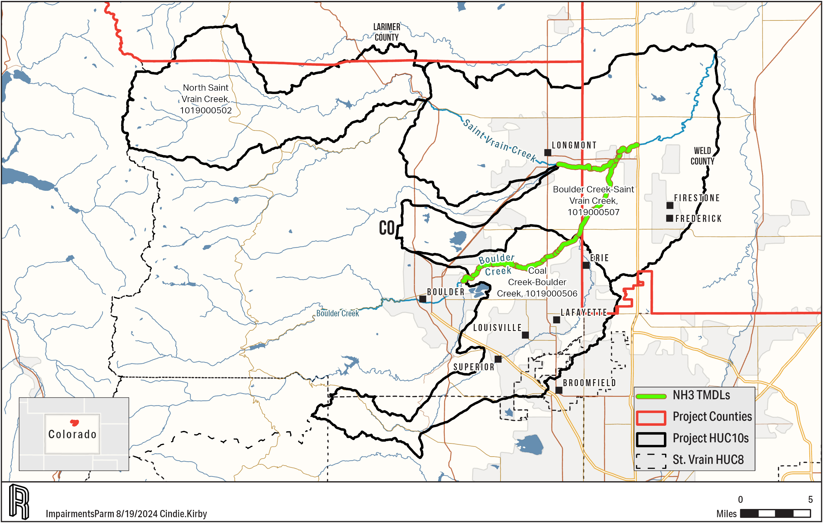
Saint Vrain Nitrogen
Notes:
Alan

Slide 18
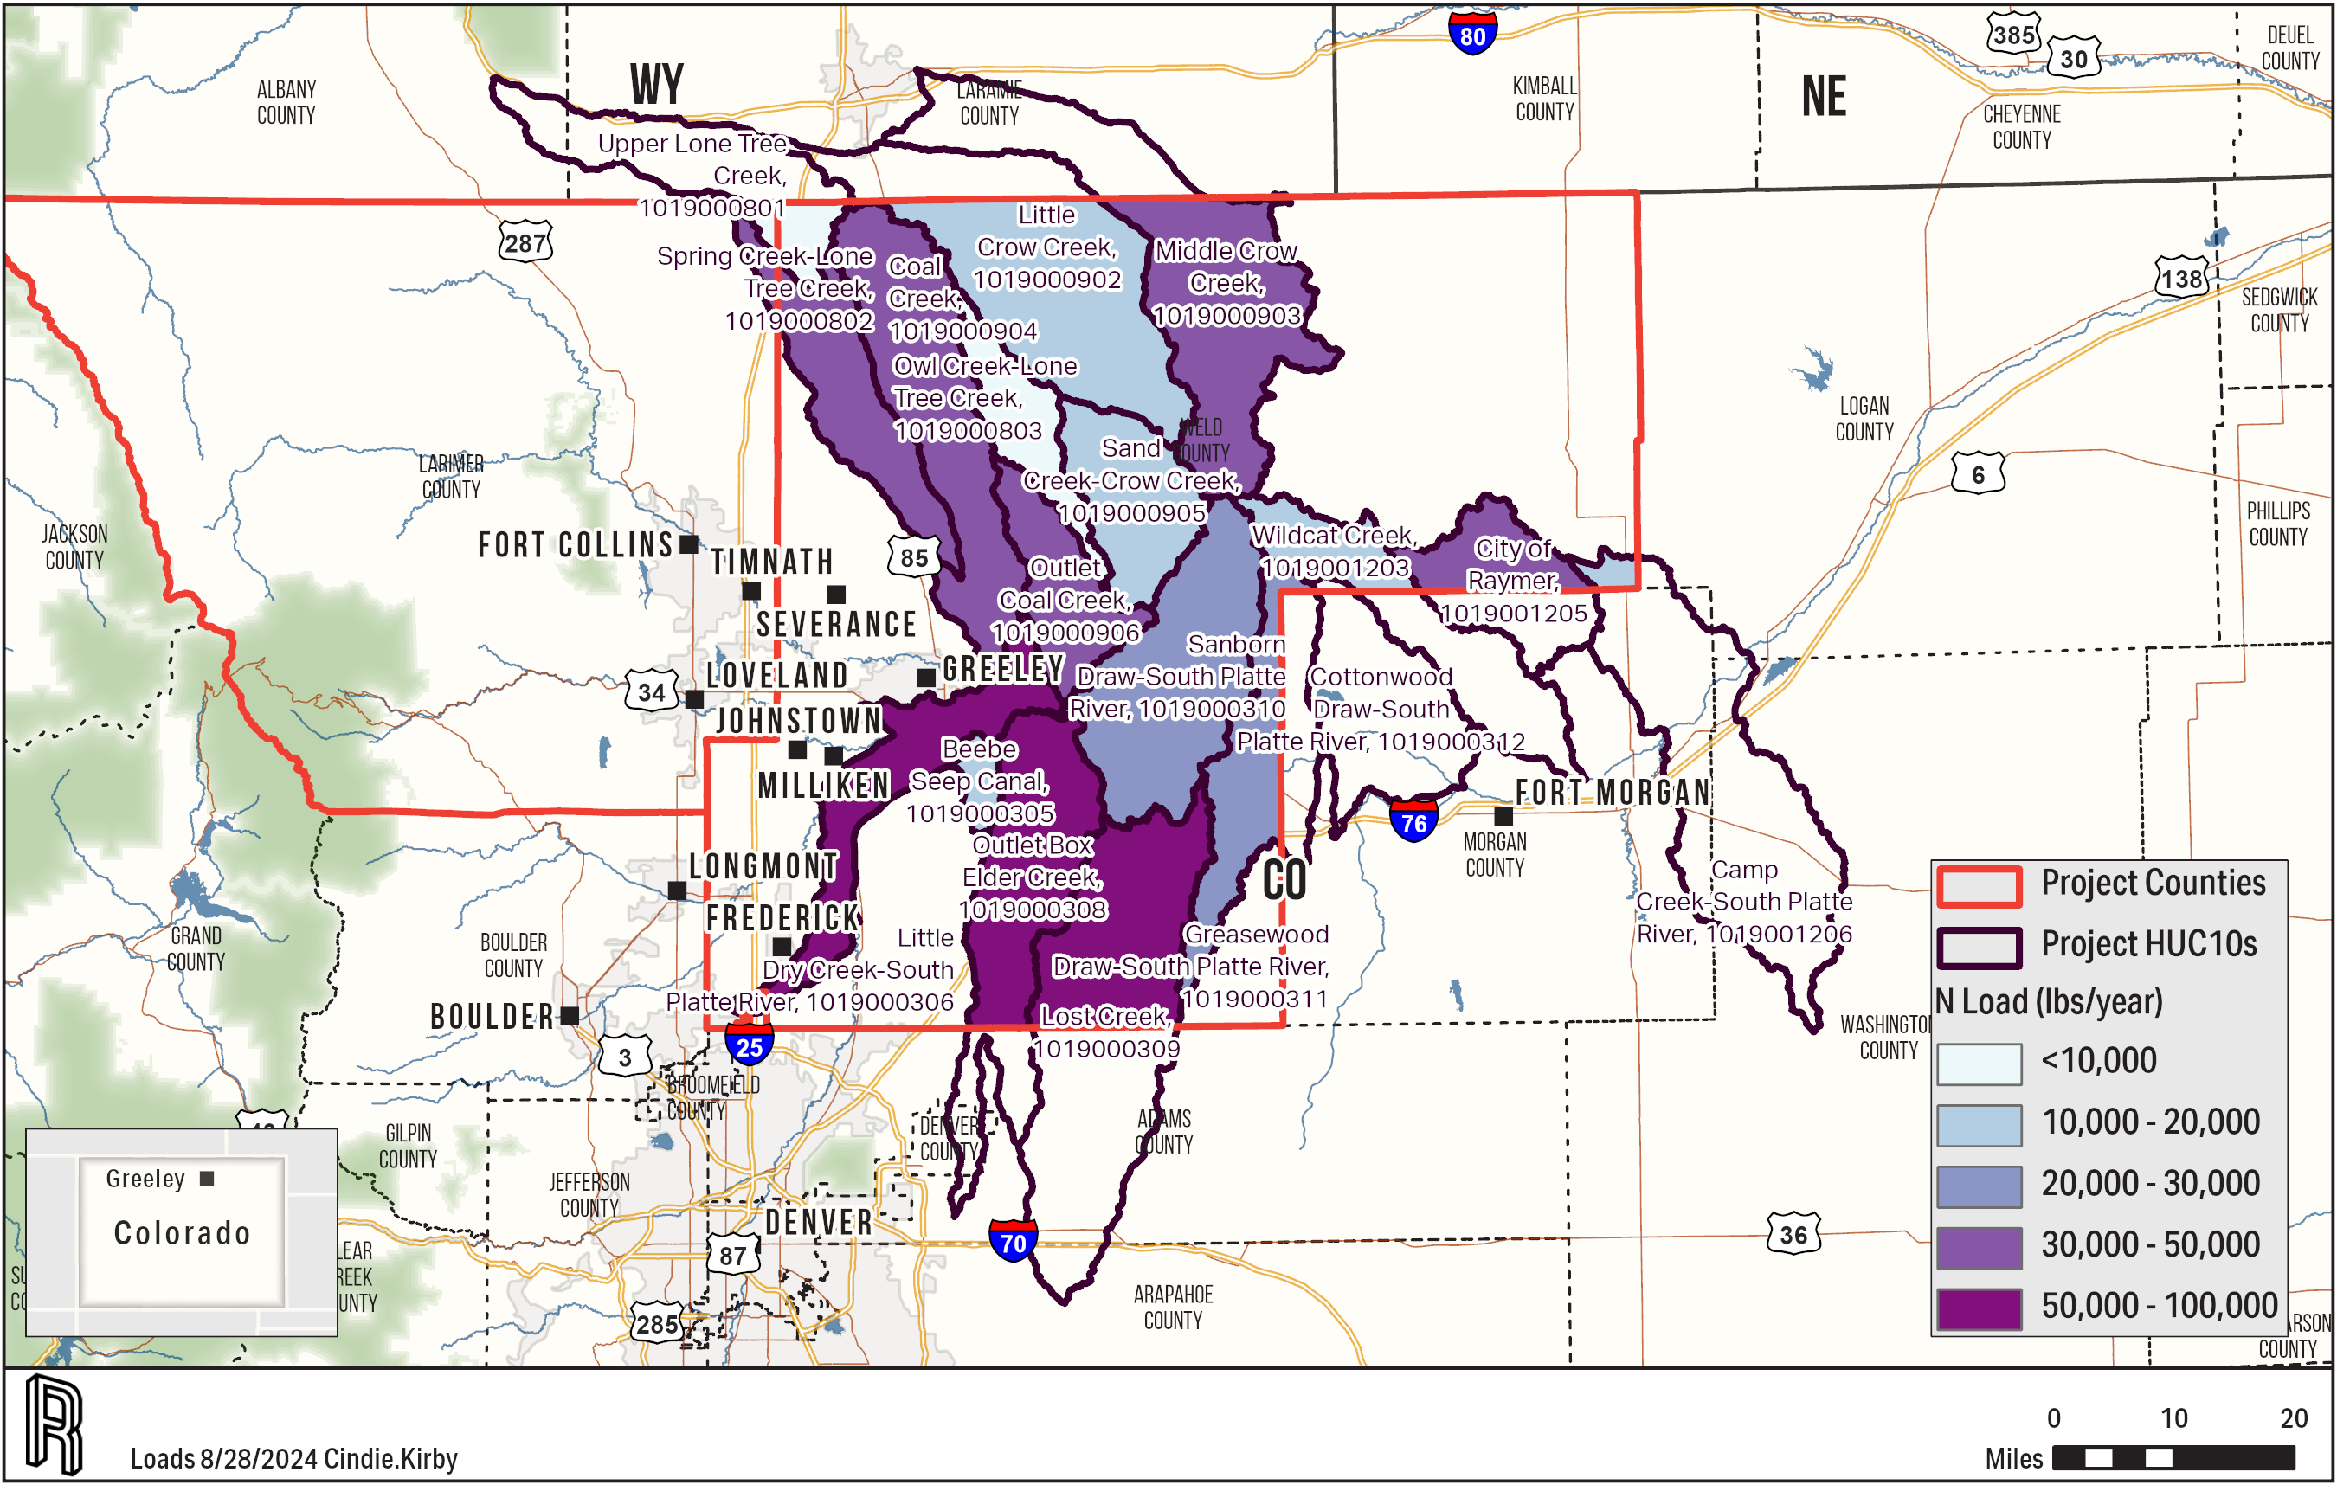
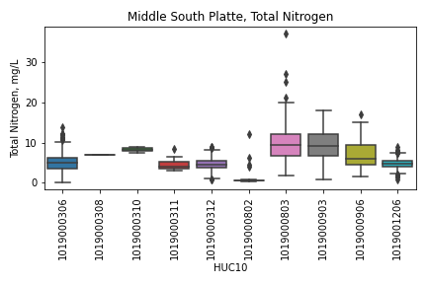
Middle South Platte Nitrogen
Notes:
Alan

Slide 19
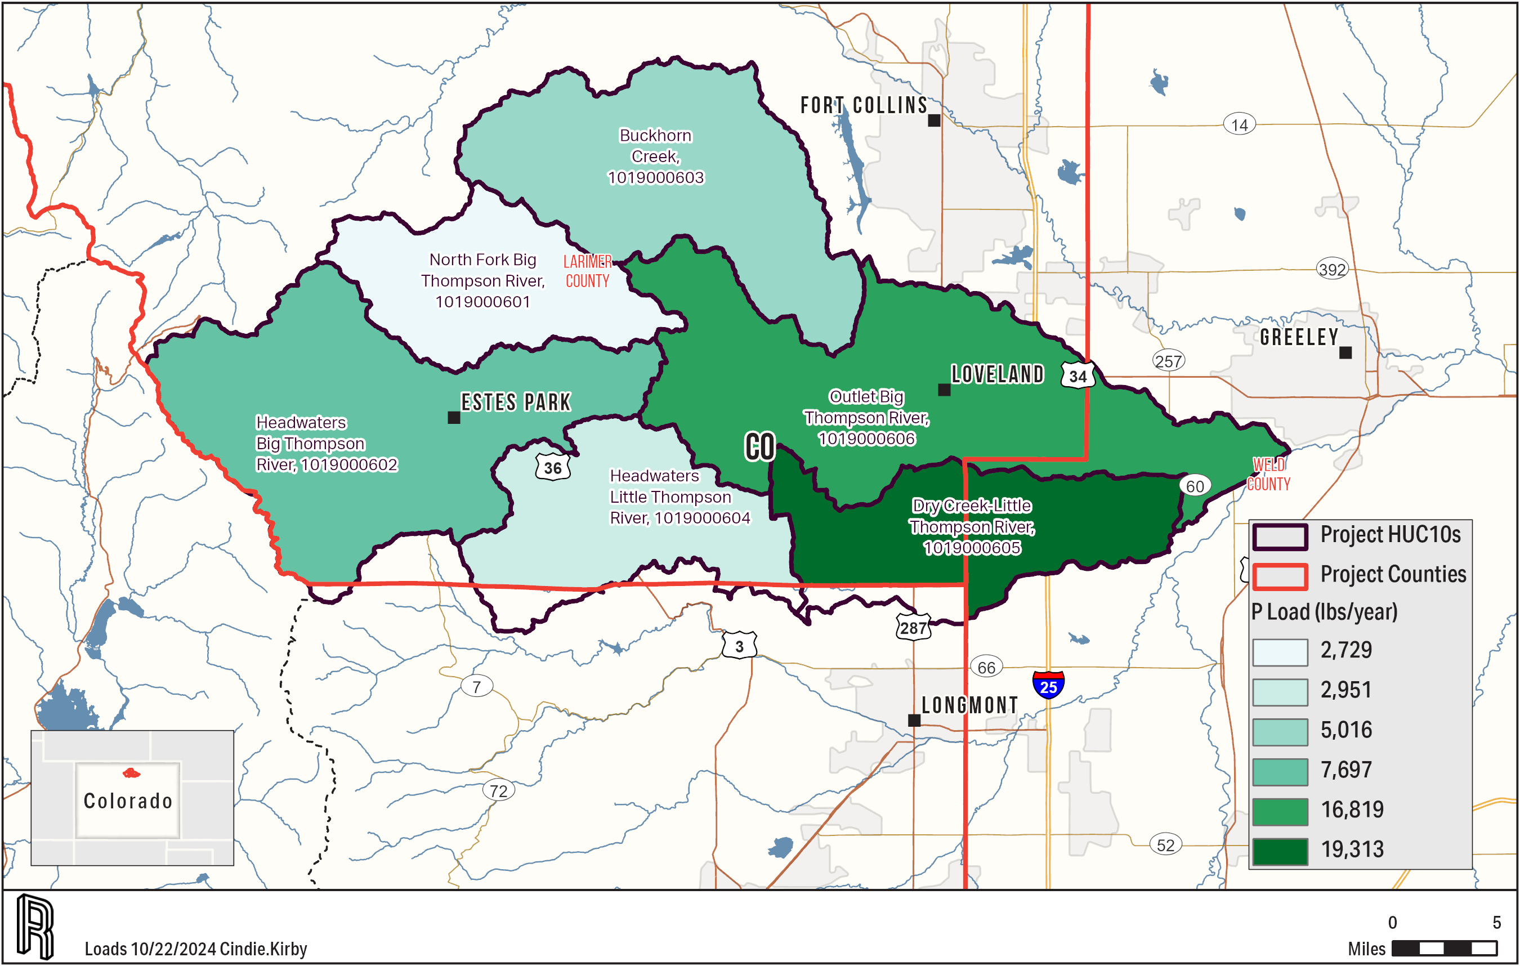
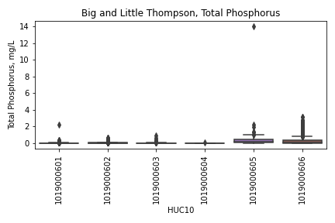
Big Little Thompson Phosphorus
Notes:
Alan

Slide 20
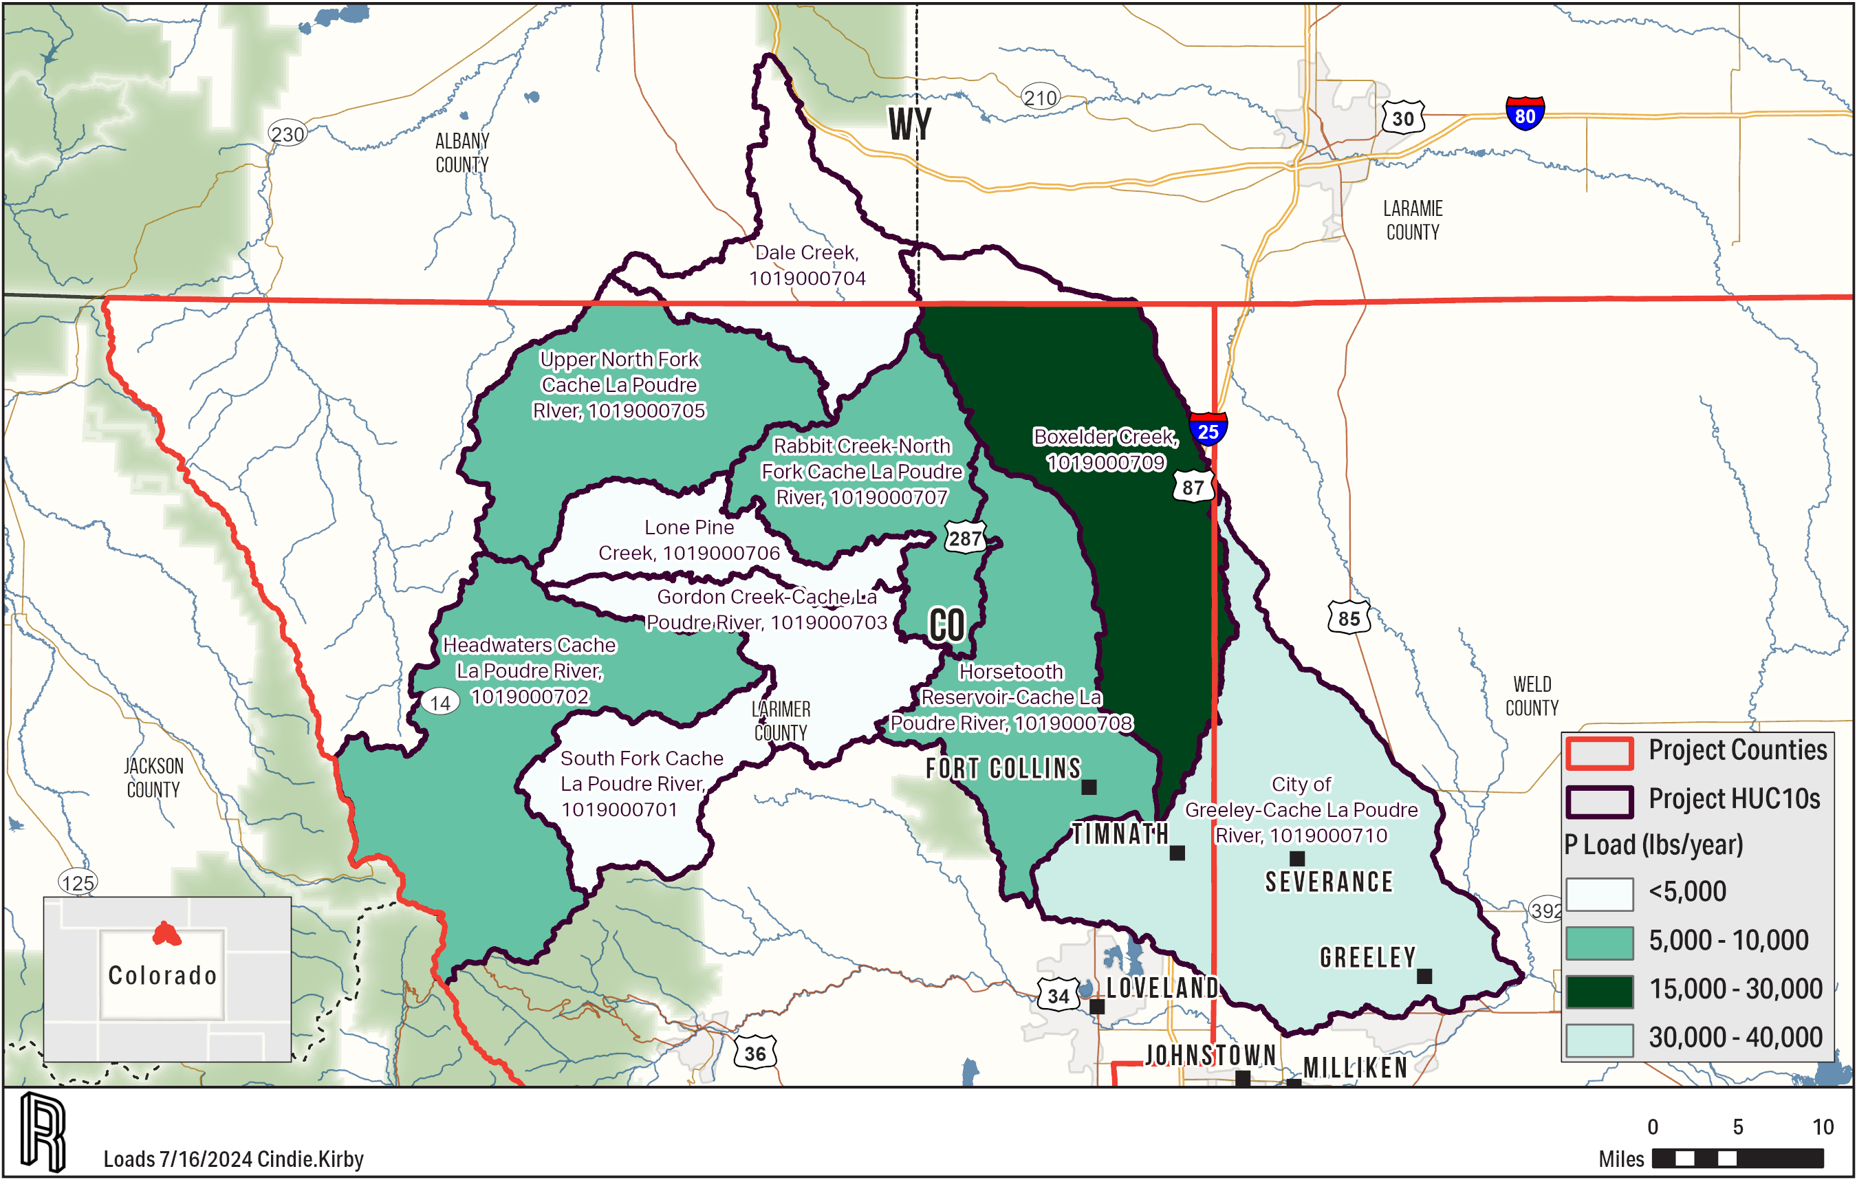
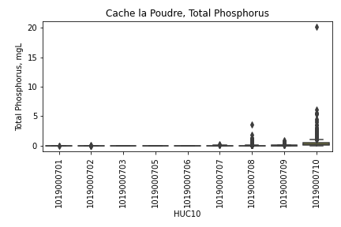
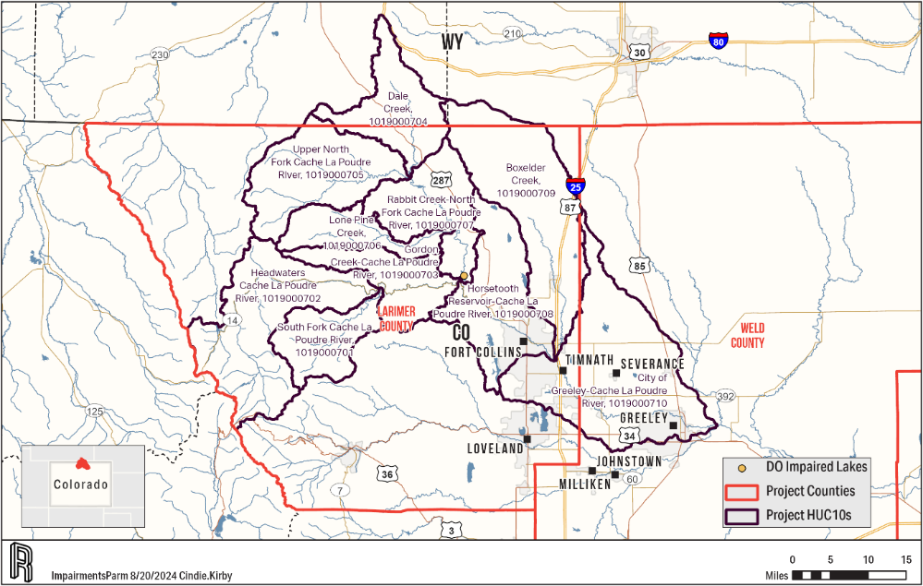
Cache la Poudre Phosphorus
Notes:
Alan

Slide 21
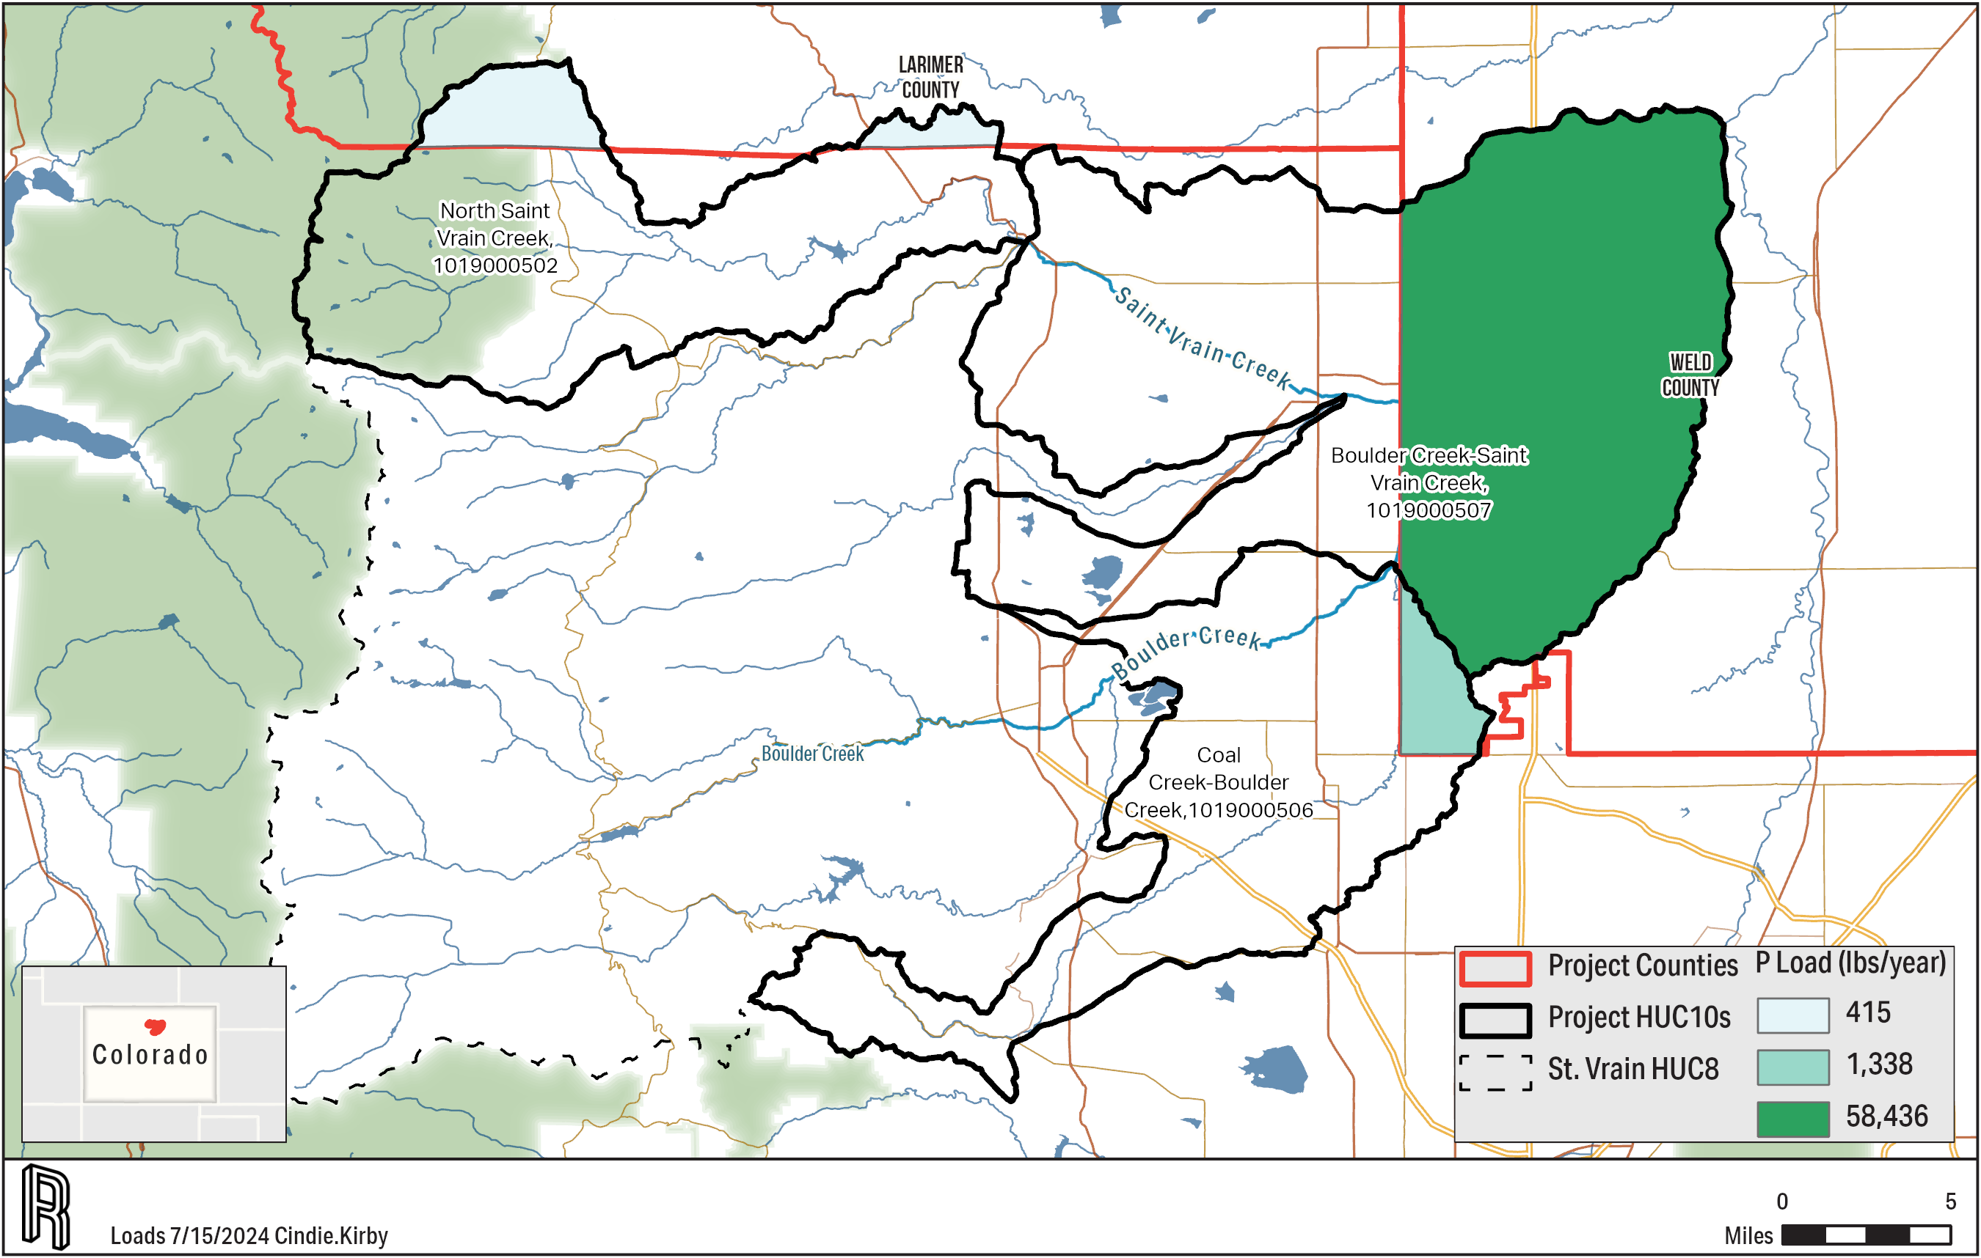
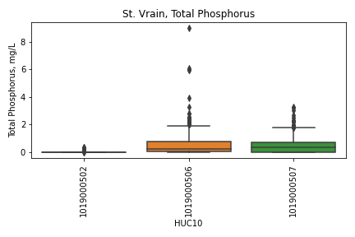
Saint Vrain Phosphorus
Notes:
Alan

Slide 22
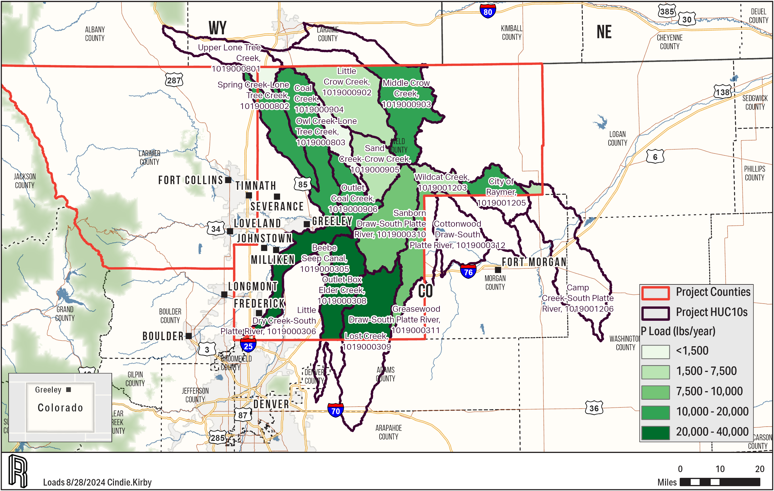
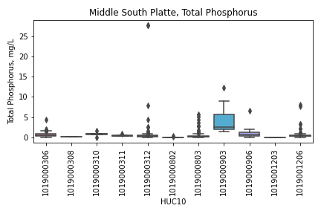
Middle South Platte Phosphorus

Slide 23
Sources of Addressed Parameters of Concern
Sediment
Cropland
Tilling fields loosens soils, and erosion is far more likely when grass or plants aren’t holding soils in place.
Development
Developed lands often have significant impervious areas (i.e. concrete/roofs of buildings, etc.). When precipitation falls on these surfaces it moves more quickly to nearby waterbodies, and it isn’t able to absorb into the ground. Therefore, flow reactions in streams increases and larger amounts occur at once. This increased flow causes more in-stream sediment to be suspended and moved downstream.
Forest
Fire can deplete root systems that hold soils in place. When a precipitation event occurs, soils are then more likely to be moved in the form of erosion.

Slide 24
Sources of Addressed Parameters of Concern
Nutrients
Nutrients are attached to sediment, so any source of sediment is also a source of nutrients.
Cropland
Manure is spread on crops/hayland containing nitrogen and phosphorus
Inorganic fertilizer is spread on crops/hayland containing nitrogen and phosphorus
Pastures and feedlots
Animals contribute waste which includes nitrogen and phosphorus
Developed areas
Failing septics can contribute to nutrients
Fertilizer is spread on parks, yards, golf courses, etc. to contribute to nutrients
Pets contribute waste which includes nitrogen and phosphorus
Notes:
Alan

Slide 25
Sediment and Nutrient Priority Practices by Land use
Urban non-MS4
Extended Wet Detention
Infiltration Basins
Cropland
Streambank Stabilization and Fencing
Grass Buffers (35+ ft)
Feedlots
Infiltration Basins
Waste Management Systems
Forest
Site Preparation/Straw/Crimp Seed/Net
Site Preparation/Straw/Crimp Seed/Fertilizer/Transplants
Wildfire Preparation and Reclamation
Notes:
Alan

Slide 26
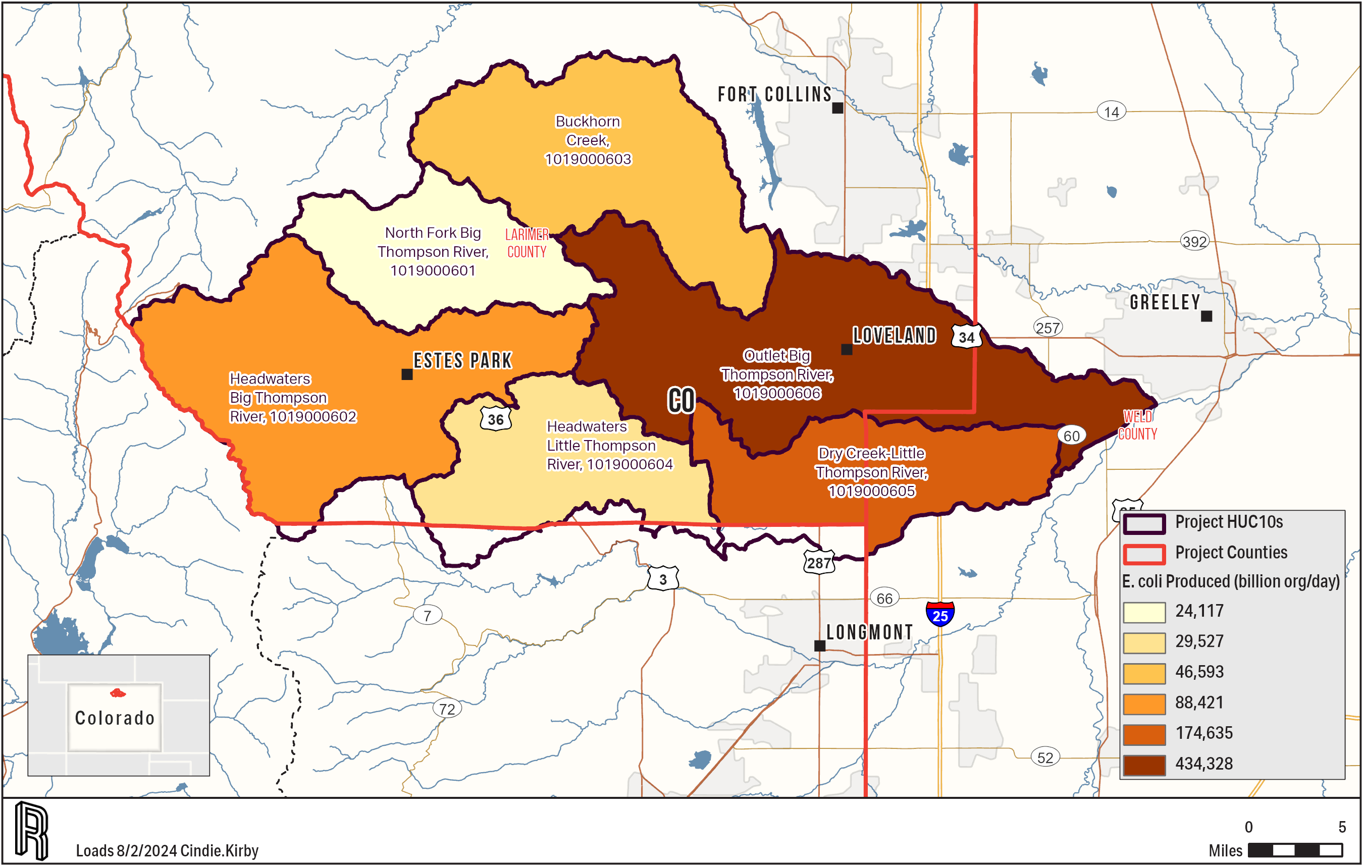
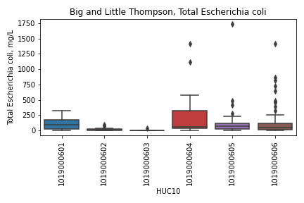
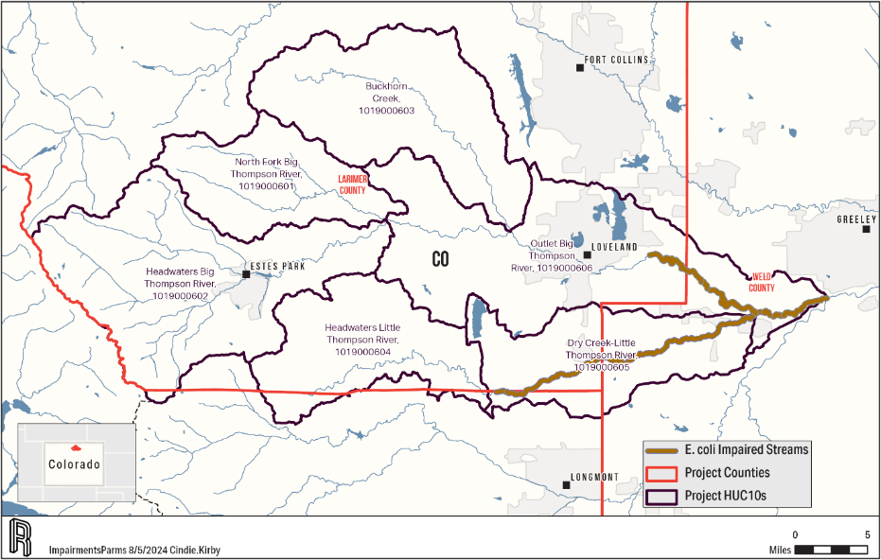
Big/Little Thompson E. coli
Notes:
Alan

Slide 27
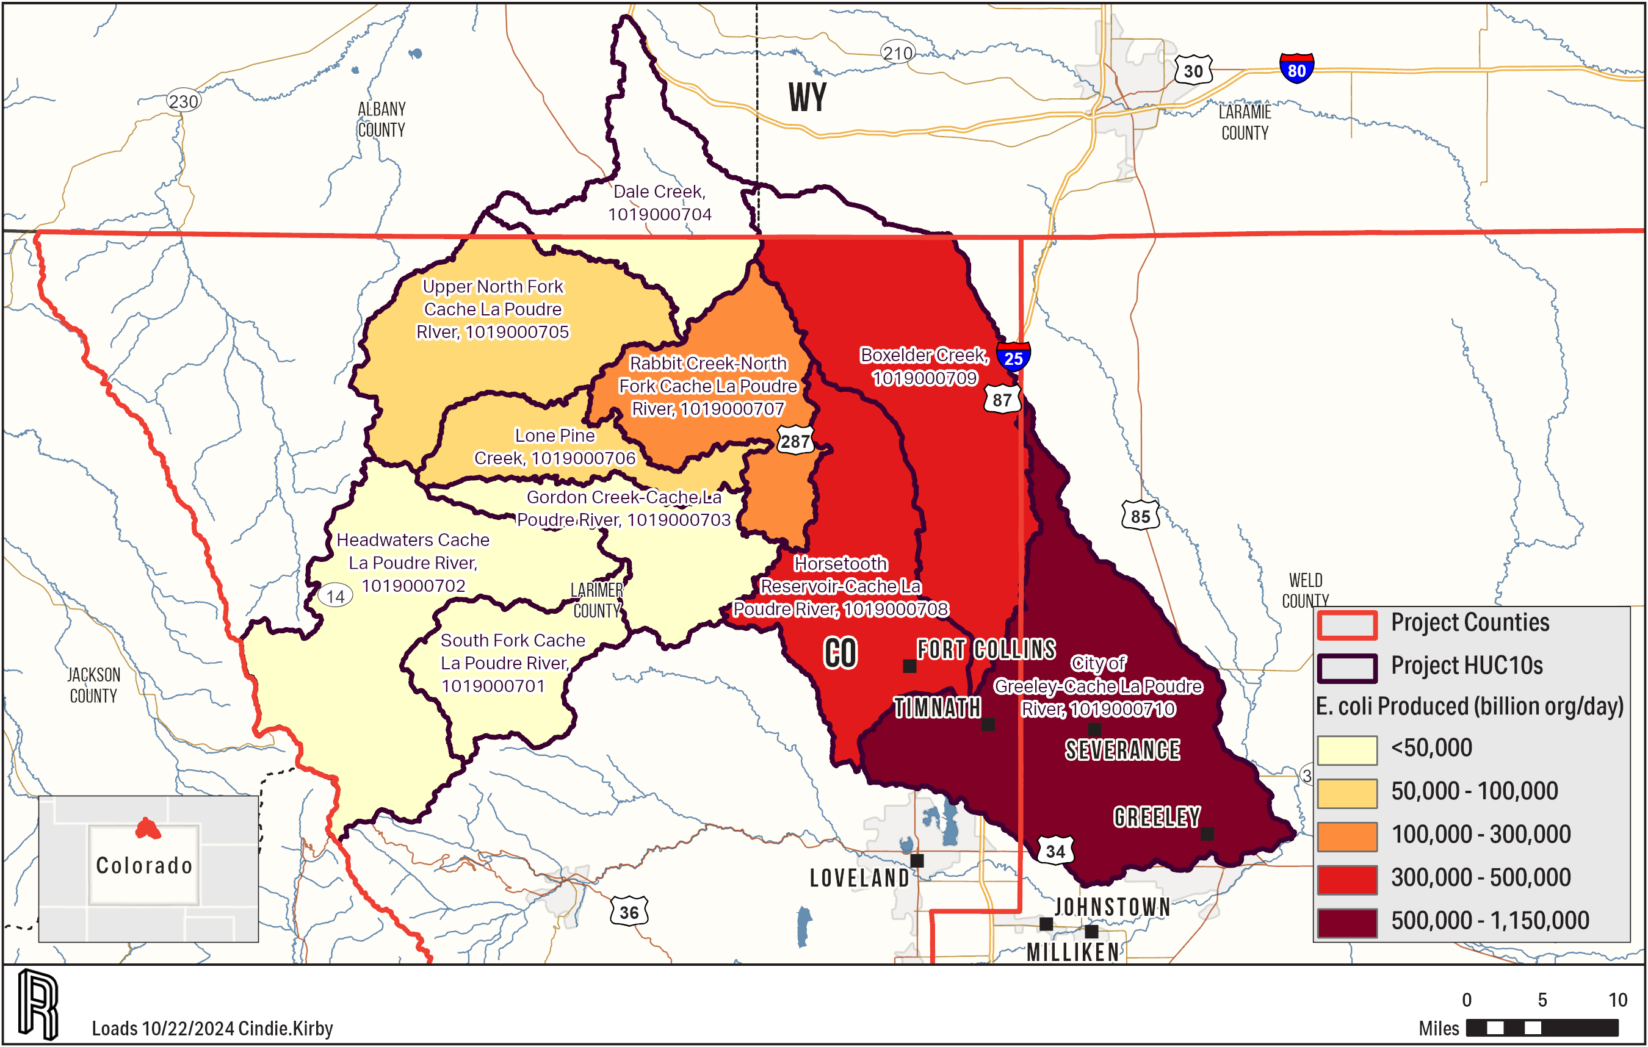
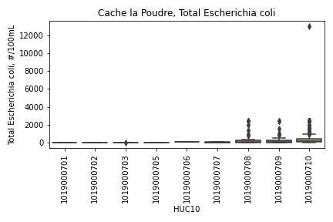
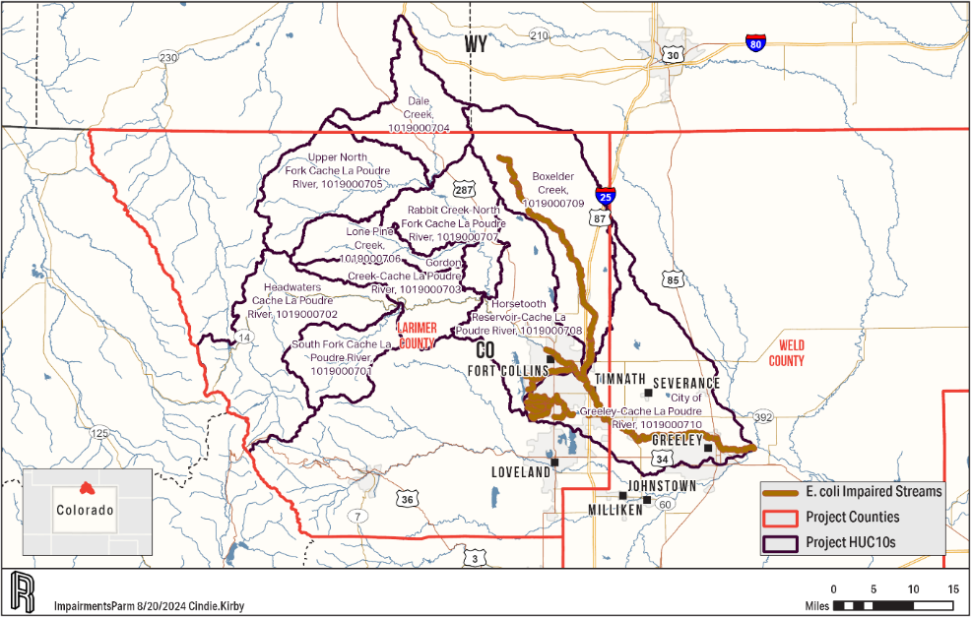
Cache La Poudre E. coli
Notes:
Alan

Slide 28
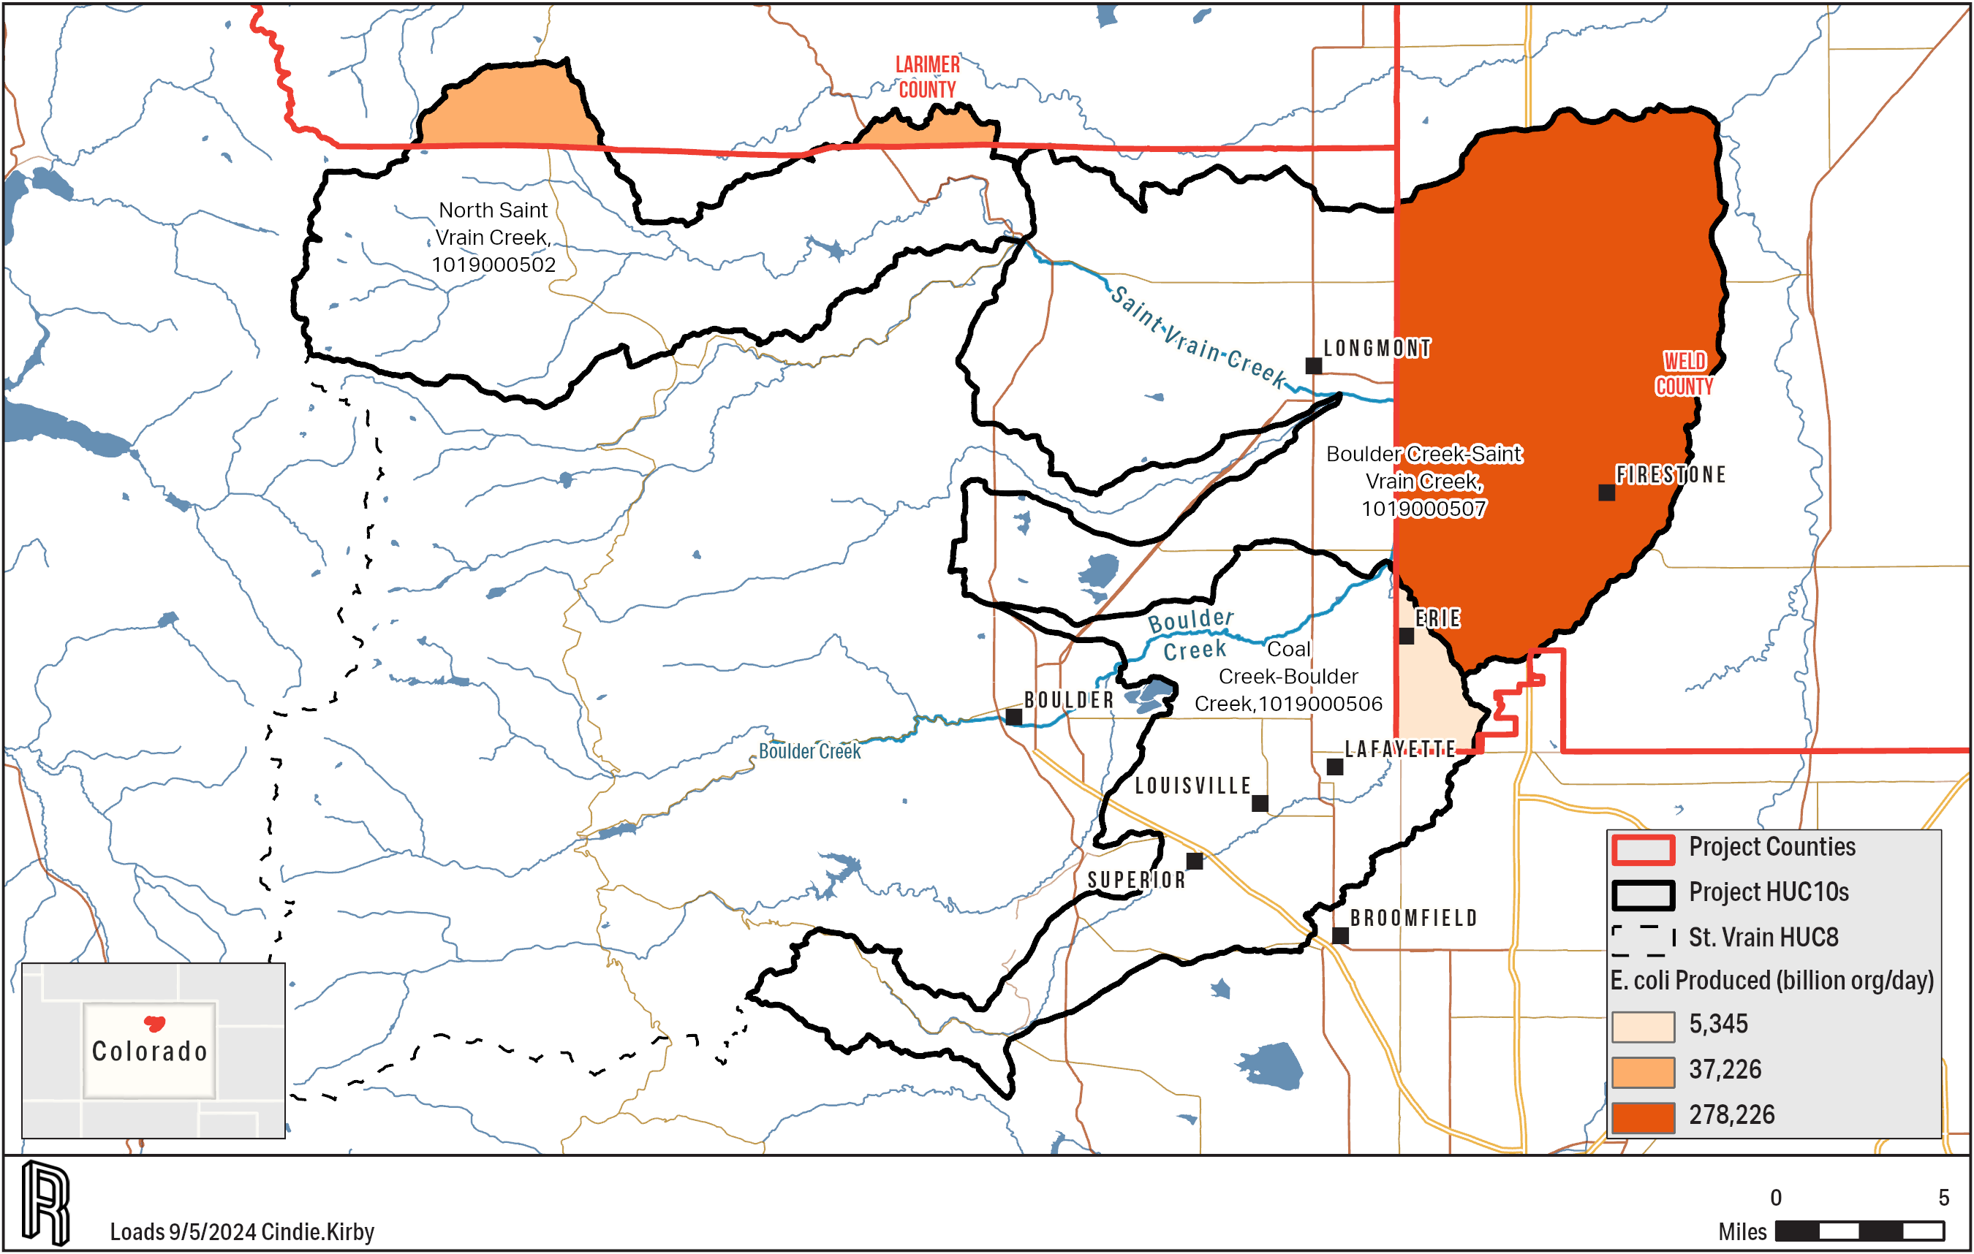
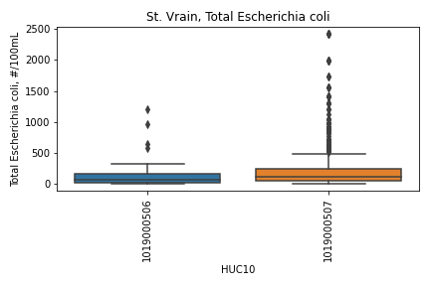
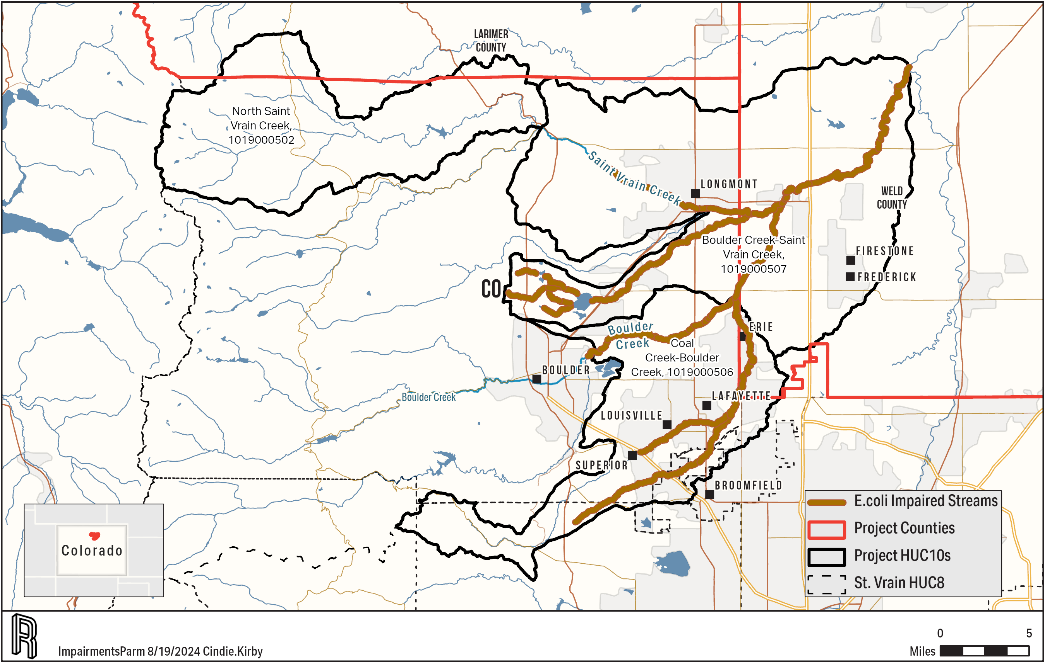
Saint Vrain E. coli
Notes:
Alan

Slide 29
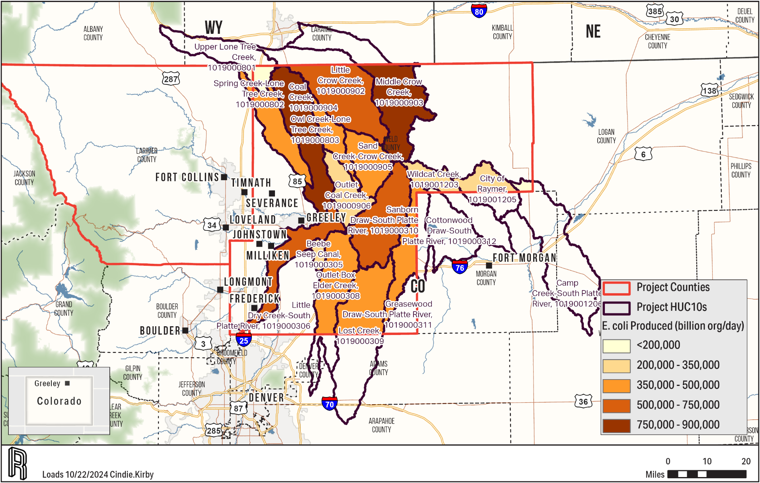
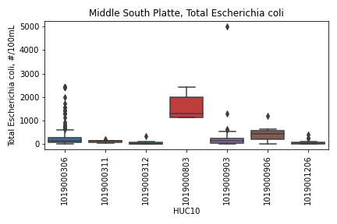
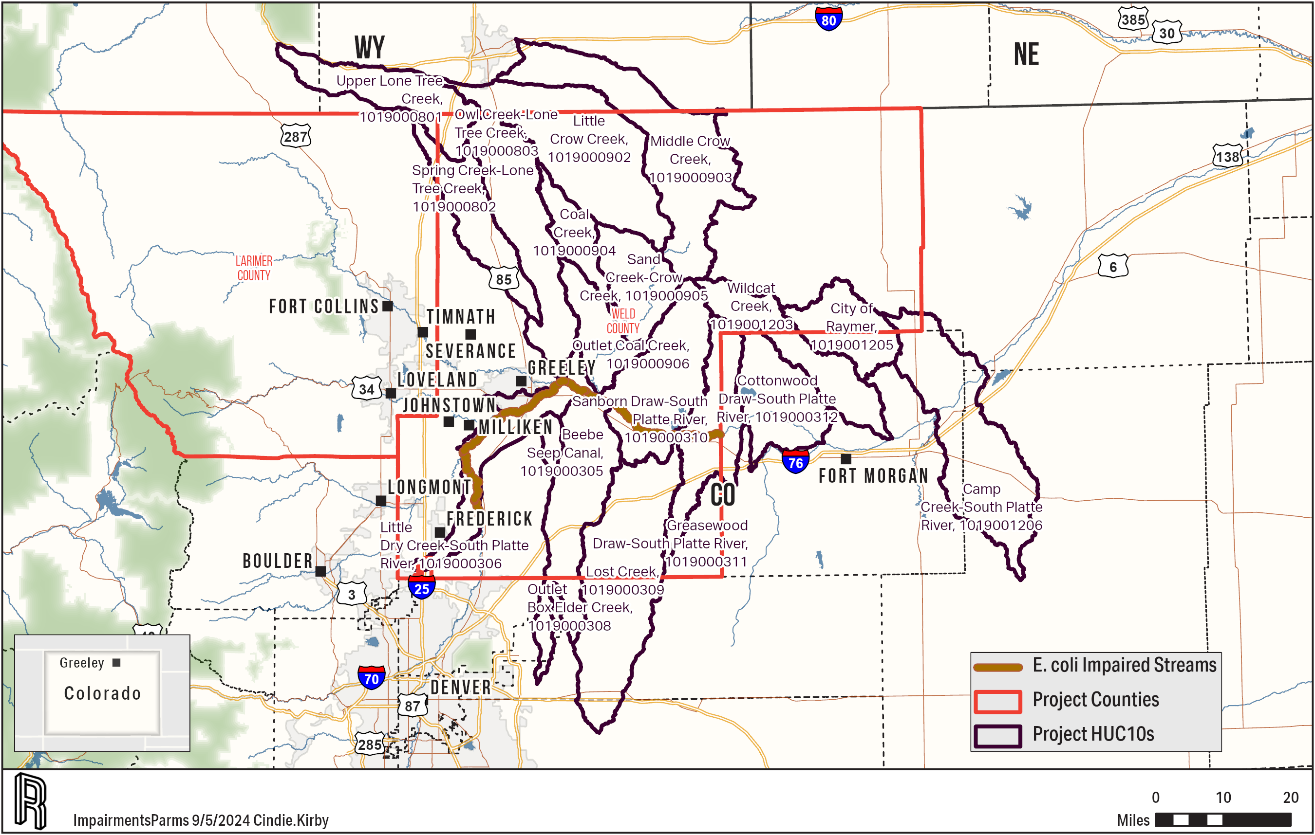
Middle South Platte E. coli
Notes:
Alan

Slide 30
Sources of Parameters of Concern
E. coli
Warm blooded animals
Humans
Septic (failing systems)
Waste water facilities (limited because generally disinfected)
Pets
Dogs in backyards not getting cleaned up after
Stray cats
Livestock
Cattle grazing or manure being spread on crops/hayland
Hog and poultry manure spread on crops/hayland
Other livestock manure
Notes:
Alan

Slide 31
E. Coli Priority Practices by Land use
Urban non-MS4
Septic Upgrades
Wastewater Treatment Facility Connections
Wetland Basins
Retention Ponds
Cropland
Vegetated Treatment Areas
Constructed Wetlands
Notes:
Alan

Slide 32
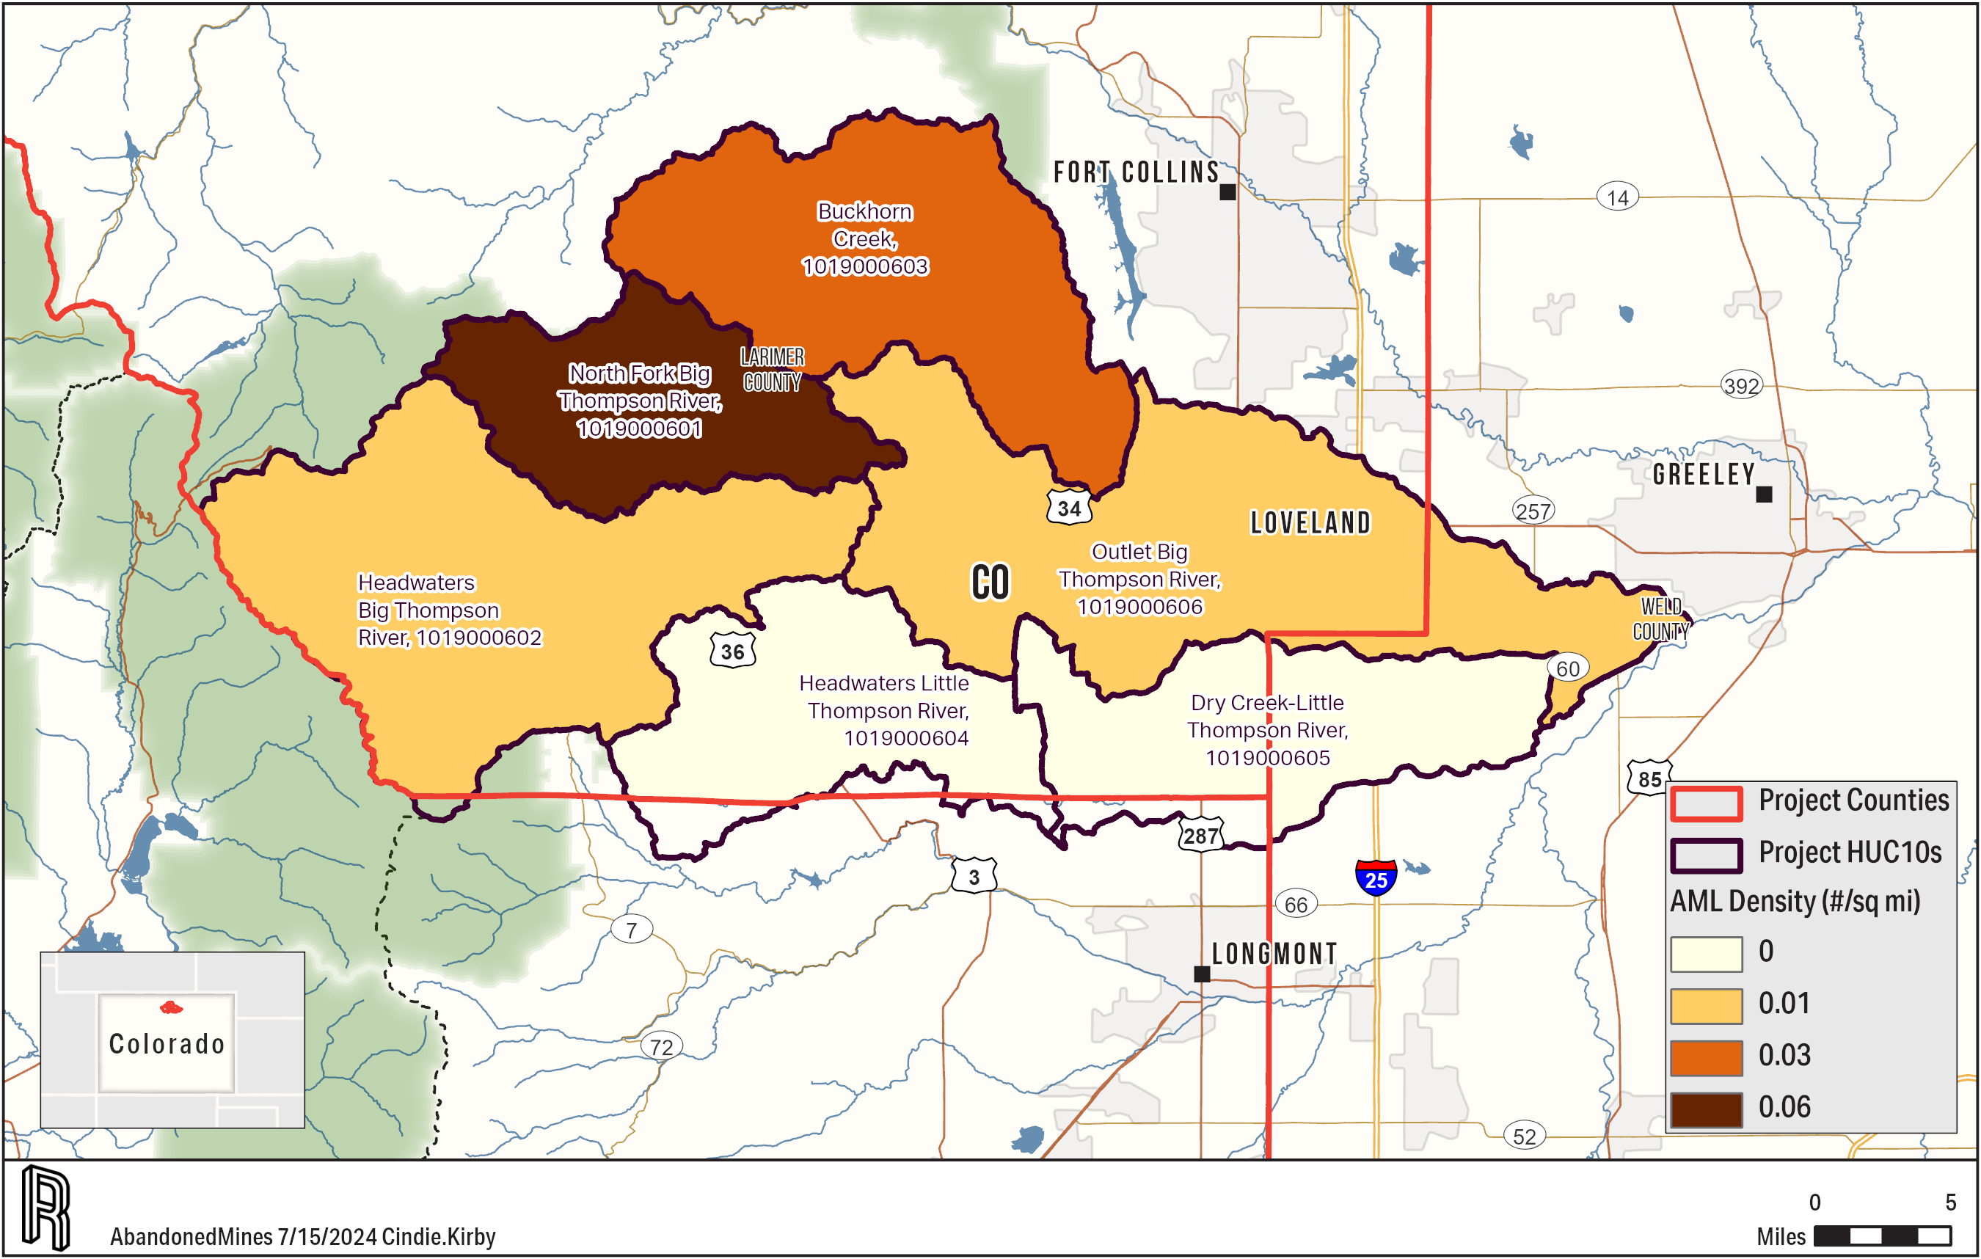
Big/Little Thompson Abandoned Mine lands
Notes:
Alan

Slide 33
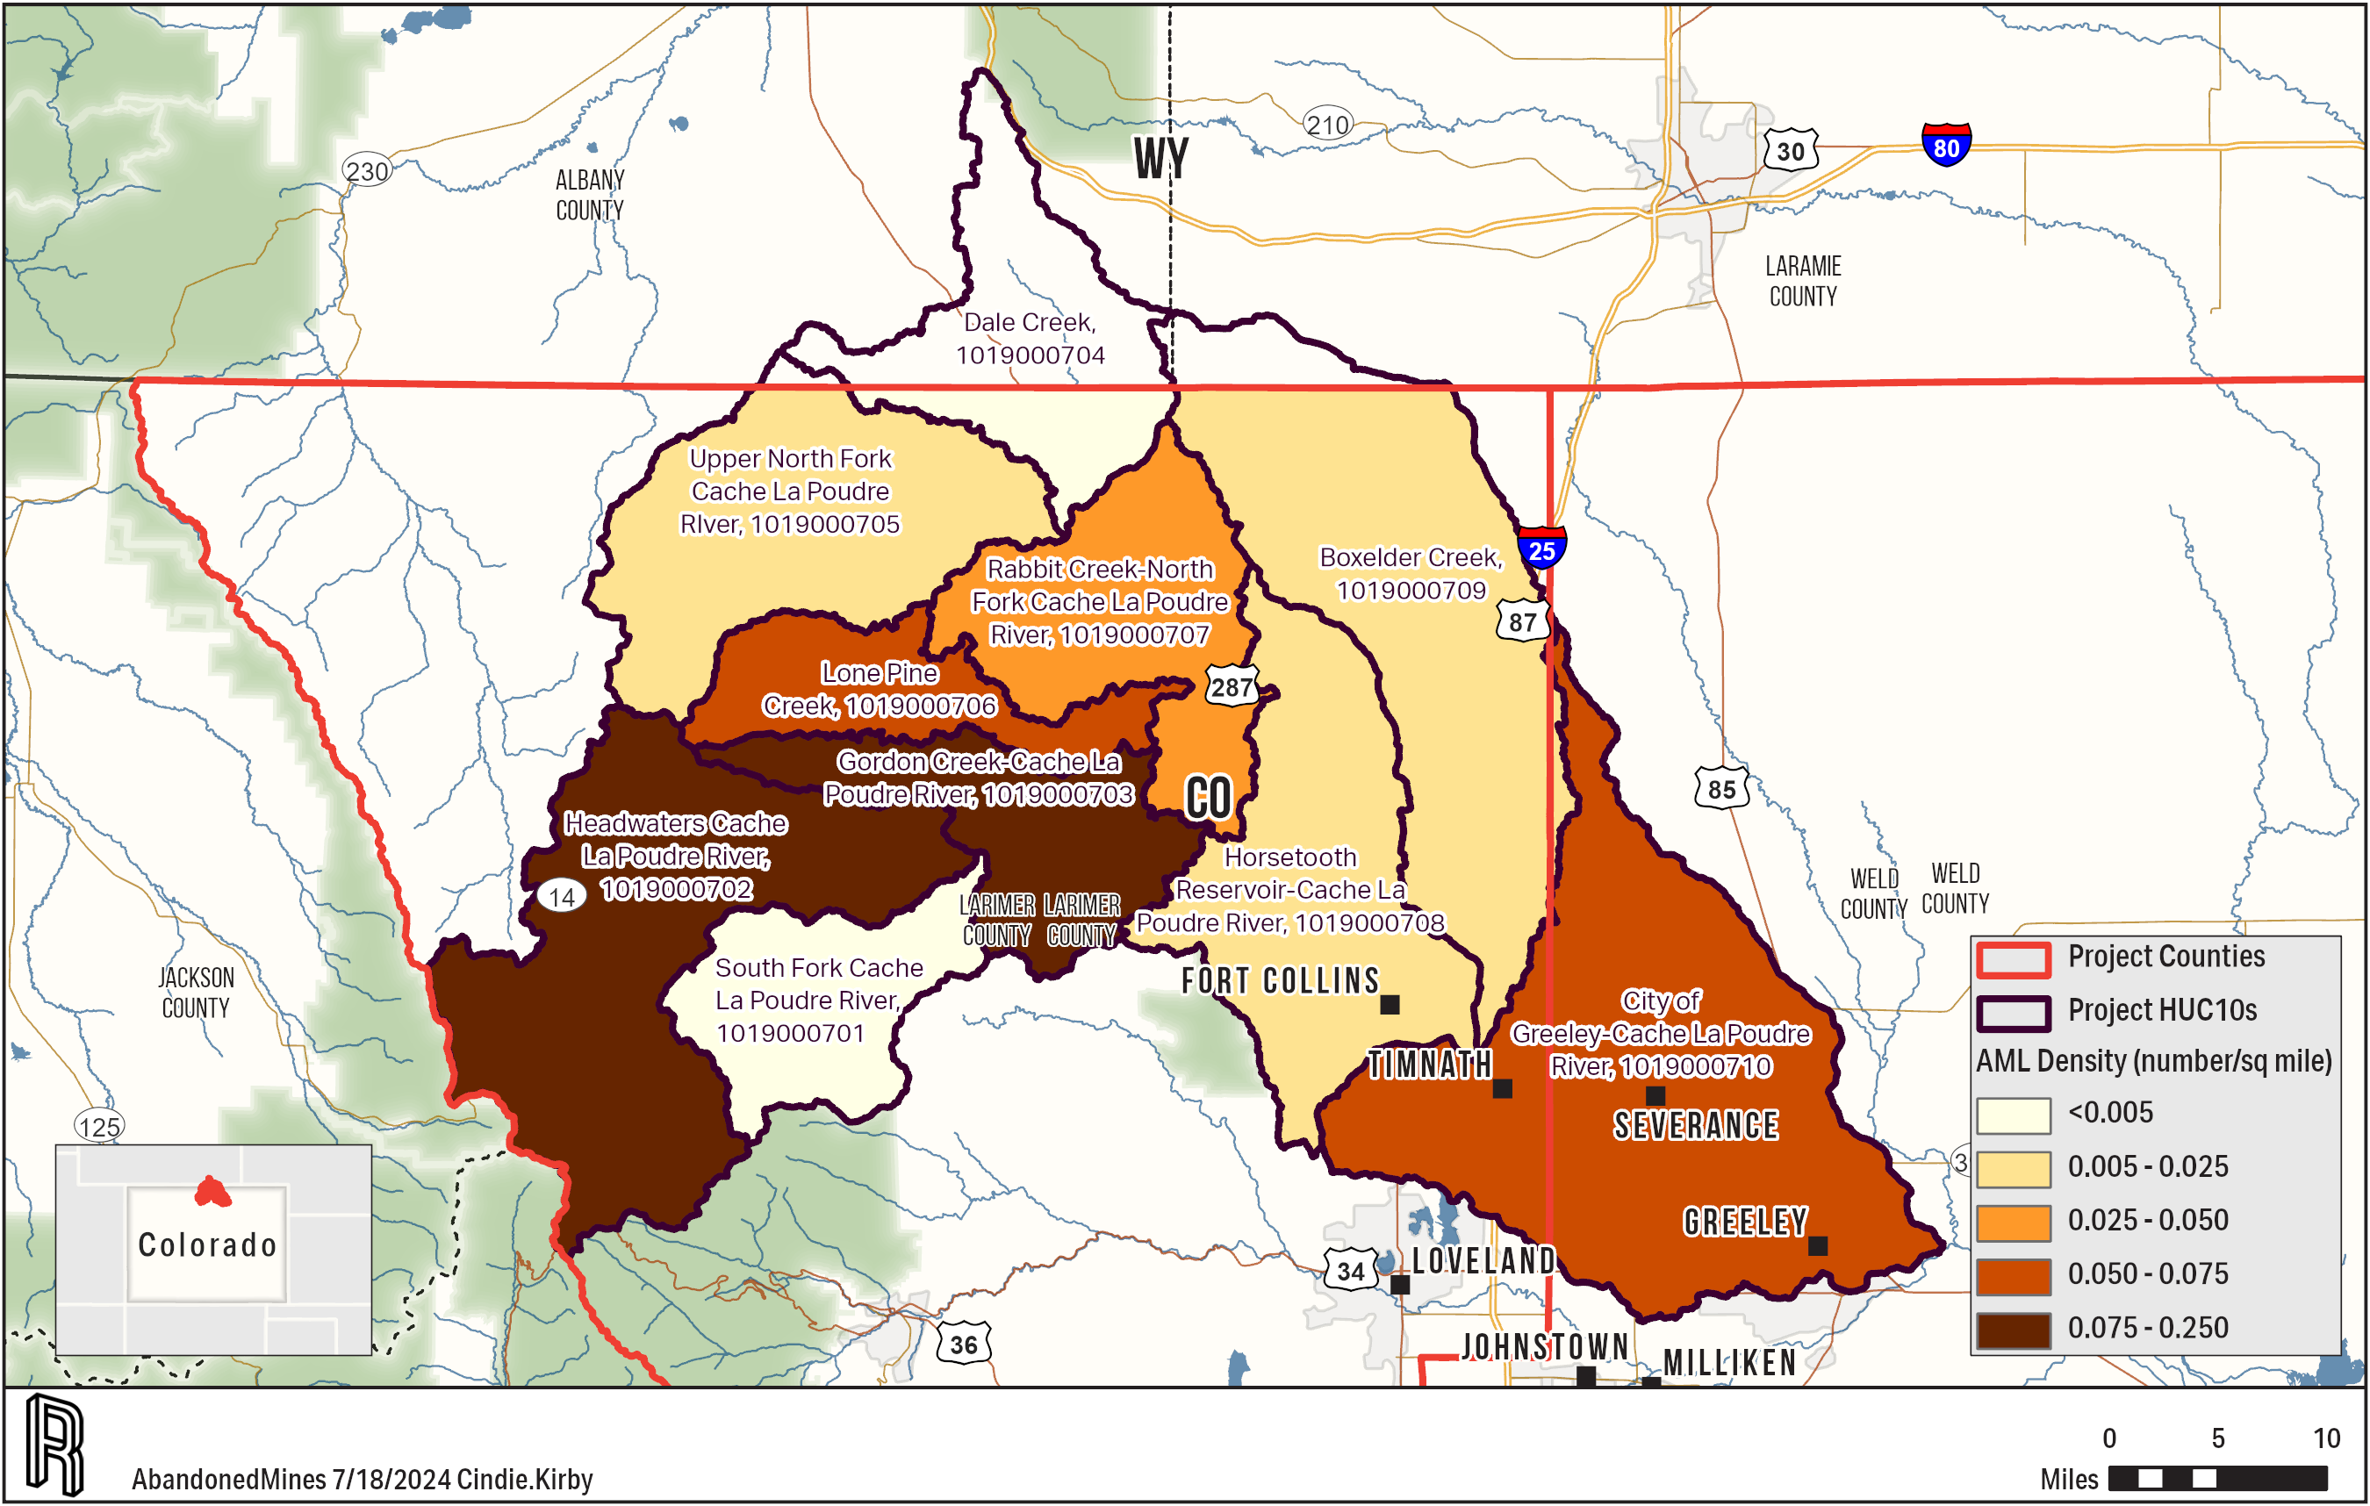
Cache la Poudre Abandoned Mine lands
Notes:
Alan

Slide 34
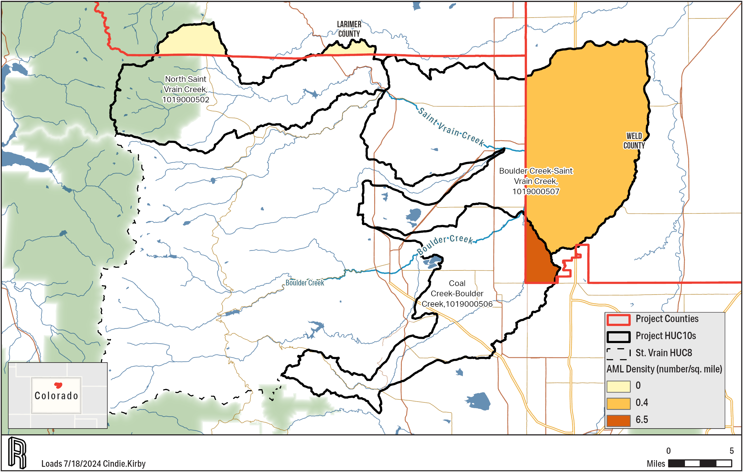
Saint Vrain Heavy Abandoned Mine lands
Notes:
Alan

Slide 35
Middle South Platte Abandoned Mine lands
Notes:
Alan

Slide 36
Sources of Addressed Parameters of Concern
Heavy Metals
Industry
Natural Sources Increased by Irrigation
Abandoned Mine Lands
Notes:
Alan

Slide 37
Heavy Metals Priority Practices by Land use
Urban non-MS4
Discontinue Use in Industry
Cropland
Irrigation Water Management
Abandoned Mine Land BMPs
Erosion and Sediment Control
Site Preparation
Storage of Soil Materials
Highwall Treatment
Placement of Surface Material
Vegetation
Control of Toxic Aqueous Discharge
Etc…
Notes:
Alan

Slide 38
Sources of Financial and Technical Assistance
Local
Agency or Organization | Website | Assistance | BMP Category
 |  |  | Developed Non-MS4 | Cropland | Pasture | Feedlot | Forest | Stream | Outreach
Cities and Towns | In main document individually | Financial, Technical | X |  |  |  |  | X | X
Counties | In main document individually | Financial, Technical | X | X | X | X | X | X | X
BTWC | bigthompson.co | Technical | X | X | X | X | X | X | X
CPRW | www.poudrewatershed.org | Technical | X | X | X | X | X | X | X
Keep it Clean Partnership | www.keepitcleanpartnership.org | Technical | X | X | X | X | X | X | X
Larimer Conservation District (Previously Fort Collins and Big Thompson Conservation Districts) | https://www.larimercd.org/ | Financial, Technical |  | X | X | X | X | X | X
Longmont and Boulder Valley Conservation District | https://bouldervalley-longmontcd.colorado.gov/ | Financial, Technical |  | X | X | X | X | X | X
Platte Valley Conservation District | www.coloradolandcan.org/local-resources/Platte-Valley-Conservation-District/3610 | Financial, Technical |  | X | X | X | X | X | X
Poudre Heritage Alliance | poudreheritage.org | Technical | X | X | X | X | X | X | X
South Platte Basin Roundtable | www.southplattebasin.com | Technical | X | X | X | X | X | X | X
West Greeley Conservation District | www.wgcd.org | Financial, Technical |  | X | X | X | X | X | X
Southeast Weld Conservation District | seweldcd-co.org | Financial, Technical |  | X | X | X | X | X | X
Notes:
Mark

Slide 39
Sources of Financial and Technical Assistance
State
Agency or Organization | Website | Assistance | BMP Category
 |  |  | Developed Non-MS4 | Cropland | Pasture | Feedlot | Forest | Stream | Outreach
CSU Extension | extension.colostate.edu | Technical | X | X | X | X | X | X | X
CSU | www.colostate.edu | Technical | X | X | X | X | X | X | X
Colorado Association of Conservation Districts | coloradoacd.org | Financial, Technical | X | X | X | X | X | X | X
CDPHE | cdphe.colorado.gov | Financial, Technical | X | X | X | X | X | X | X
Colorado Parks and Wildlife | cpw.state.co.us | Financial, Technical |  |  |  |  | X | X | X
Colorado Livestock Association | www.coloradolivestock.org | Technical |  |  |  | X |  | X | X
Colorado Department of Agriculture | ag.colorado.gov | Financial, Technical |  | X | X | X |  | X | X
Colorado Water Center | watercenter.colostate.edu | Technical |  |  |  |  |  | X | X
Colorado Rural Water Association | www.crwa.net | Technical |  |  |  |  |  | X | X
Colorado DNR | dnr.colorado.gov | Financial, Technical | X | X | X | X | X | X | X
Colorado Energy and Carbon Management Commission | ecmc.state.co.us | Financial, Technical |  | X | X | X
Colorado Geological Survey | coloradogeologicalsurvey.org | Financial, Technical |  |  |  |  |  | X
Colorado Bureau of Land Management | www.blm.gov | Financial, Technical |  |  |  |  | X | X | X
Colorado Division of Reclamation, Mining, and Safety | drms.colorado.gov | Financial, Technical |  |  |  |  | X | X | X
Colorado State Land Board | slb.colorado.gov | Financial |  |  |  |  |  |  | X
Notes:
Mark

Slide 40
Sources of Financial and Technical Assistance
Federal and Private
Agency or Organization | Website | Assistance |  |  |  | BMP Category
 |  |  | Developed Non-MS4 | Cropland | Pasture | Feedlot | Forest | Stream | Outreach
FEDERAL
U.S. Army Corps of Engineers | www.usace.army.mil | Financial, Technical |  |  |  |  |  | X | X
USDA–NRCS | www.nrcs.usda.gov | Financial, Technical |  | X | X | X | X | X | X
USDA–Farm Service Agency | www.fsa.usda.gov | Financial, Technical |  | X | X | X |  | X | X
USDA–Rural Development | www.rurdev.usda.gov | Financial, Technical |  |  |  |  |  | X | X
USDA–Bureau of Land Management | www.blm.gov | Financial, Technical |  |  |  |  | X | X | X
U.S. Department of Interior–Bureau of Reclamation | www.usbr.gov | Financial, Technical | X | X |  |  | X | X | X
EPA | www.epa.gov | Financial, Technical | X | X | X | X | X | X | X
USDA–Forest Service | www.fs.fed.us | Financial, Technical |  |  |  |  | X | X | X
USFWS | www.fws.gov | Financial, Technical |  |  |  |  |  | X | X
USGS | www.usgs.gov | Technical |  |  |  |  |  | X | X
PRIVATE
Ducks Unlimited | www.ducks.org | Financial, Technical |  |  |  |  |  | X | X
Colorado Trout Unlimited | coloradotu.org | Financial, Technical |  |  |  |  |  | X | X
Fresh Water Trust | www.thefreshwatertrust.org | Financial, Technical | X | X | X | X | X | X | X
Mule Deer Foundation | www.muledeer.org | Financial, Technical |  |  |  |  | X | X | X
Rocky Mountain Elk Foundation | www.rmef.org | Financial, Technical |  |  |  |  | X | X | X
National Fish and Wildlife Foundation | www.nfwf.org | Financial, Technical |  |  |  |  |  | X | X
Notes:
Mark

Slide 41
Thank you! Questions?
RESPEC.COM
Notes:
Mark

